Slide 1
RDA and Authority Records: Enhancing Discovery
Adam L. Schiff
Principal Cataloger
University of Washington Libraries
aschiff@uw.edu
OLA Conference 2014
April 17, 2014

Slide 2
RDA Framework
RDA is aligned with two conceptual models:
  FRBR (Functional Requirements for Bibliographic Records)
  FRAD (Functional Requirements for Authority Data)
Entity-relationship models
Person, Family, Corporate Body, Place
Work, Expression

Slide 3
Entities and Attributes
Each entity has various attributes, e.g.
Person: Gender, Date of Birth, Date of Death, Place of Birth, Associated Country, Affiliation, Language, Profession/Occupation, etc.
Entities can have relationships with other entities, e.g.
Corporate Body B is the successor of Corporate Body A
Person is the founder of Corporate Body
Work A was adapted into Work B
Person is the translator of Expression of Work

Slide 4
MARC 21 Authority Format
New fields and subfields to record attributes
New subfields and codes to explicitly record the nature of relationships
LC-PCC Policy Statements, NACO documentation, and PCC best practices and guidelines have been developed
Notes:
Over several years, the MARC 21 Authority Format was revised and augmented to accommodate new RDA elements and attributes.

Slide 5
Documentation
MARC 21 Authority Format
http://www.loc.gov/marc/authority/
Descriptive Cataloging Manual (DCM) Section Z1
and
LC Guidelines Supplement to MARC 21 Format for Authority Data
http://www.loc.gov/catdir/cpso/z1andlcguidelines.html
Notes:
These are also available in Cataloger’s Desktop. The DCM Z1 supplements the MARC 21 Authority Format and provides information on LC and PCC practices regarding coding of authority fields. The LC Guidelines Supplement provides information on which authority fields and subfields are or aren’t used in name, series, and subject authority records created by LC or by NACO and SACO participants.

Slide 6
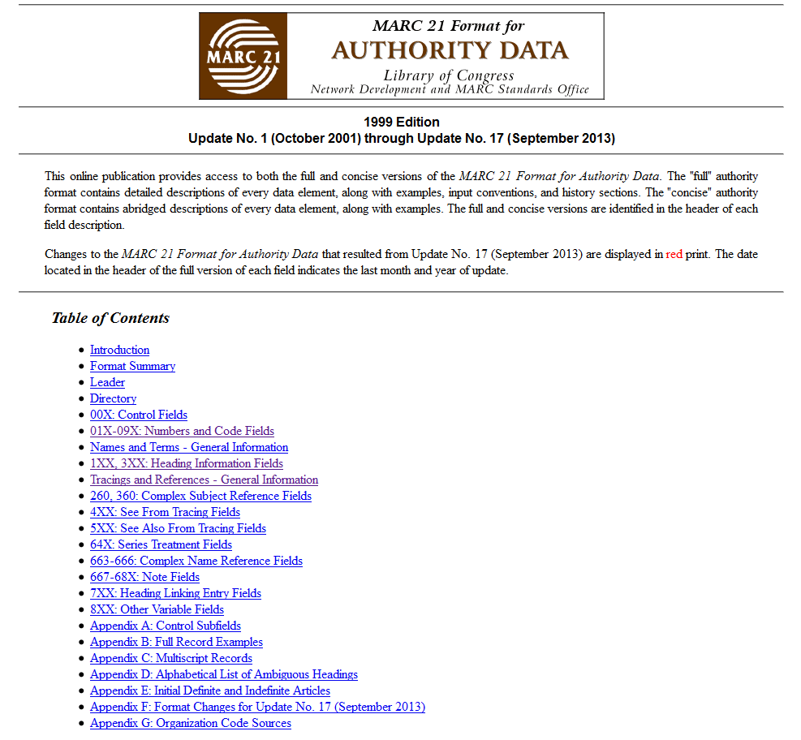
Notes:
Home page of the MARC 21 Format for Authority Data. Most of the new MARC 21 fields are found by clicking on “1XX, 3XX: Heading Information Fields”.

Slide 7
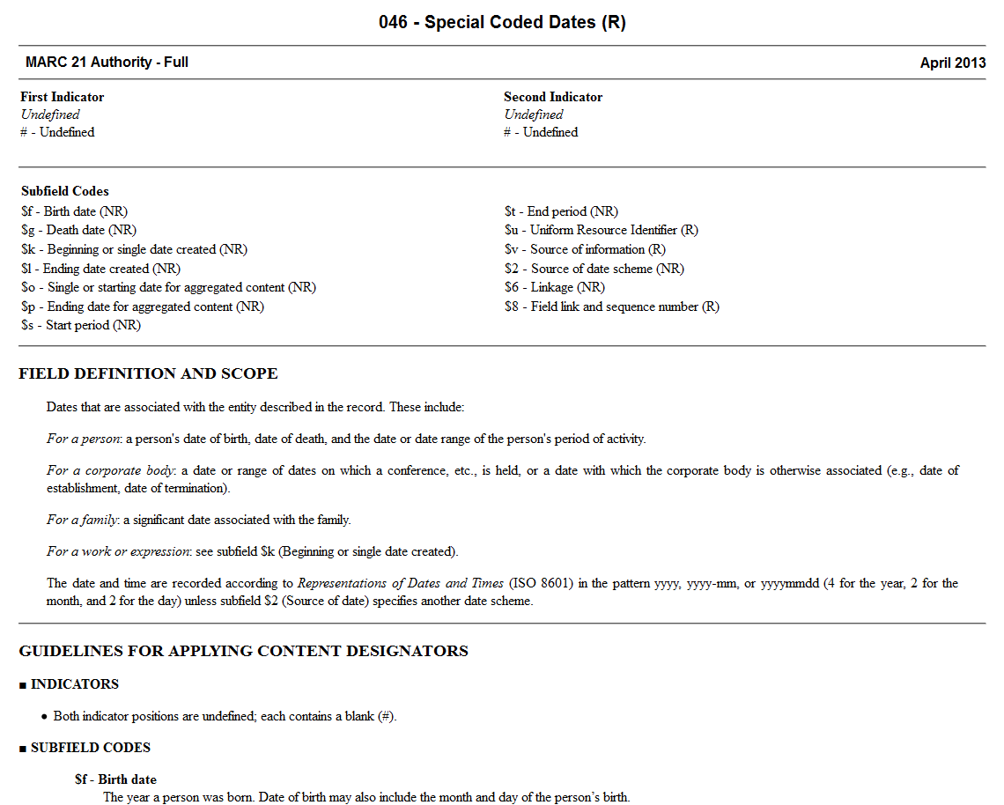
Notes:
Here’s the MARC specifications for the 046 field for special coded dates.

Slide 8
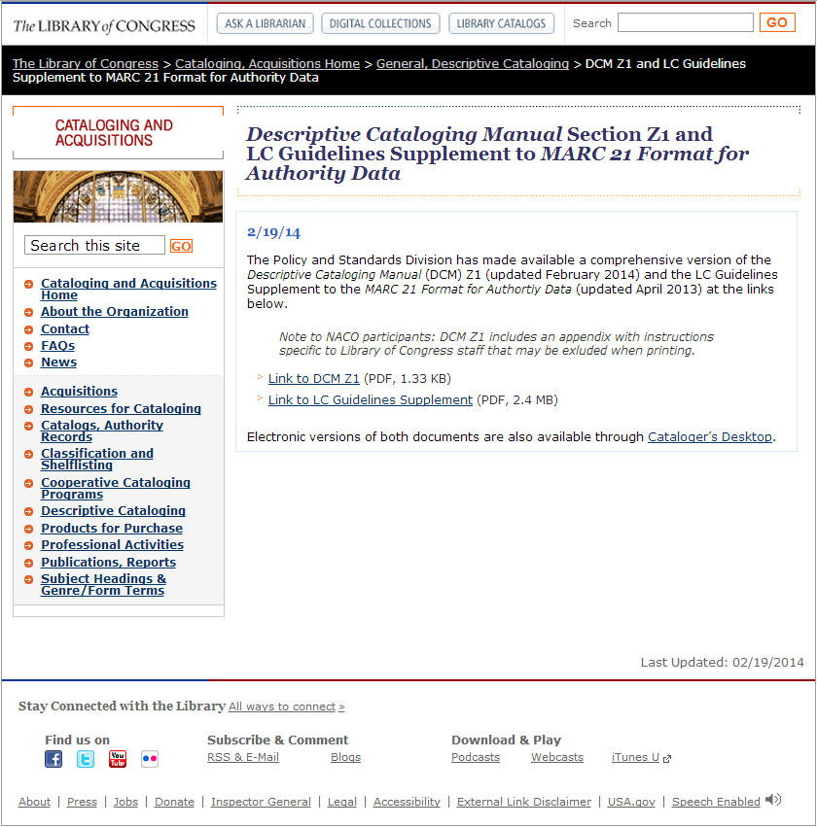
Notes:
Home page for the DCM Z1 and LC Guidelines Supplement. These are available in PDF as well as through Cataloger’s Desktop.

Slide 9
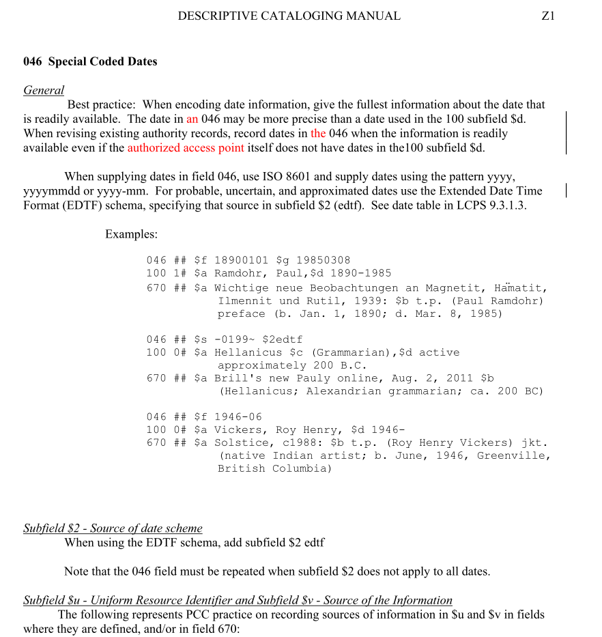
Notes:
The 046 page from the DCM Z1.

Slide 10
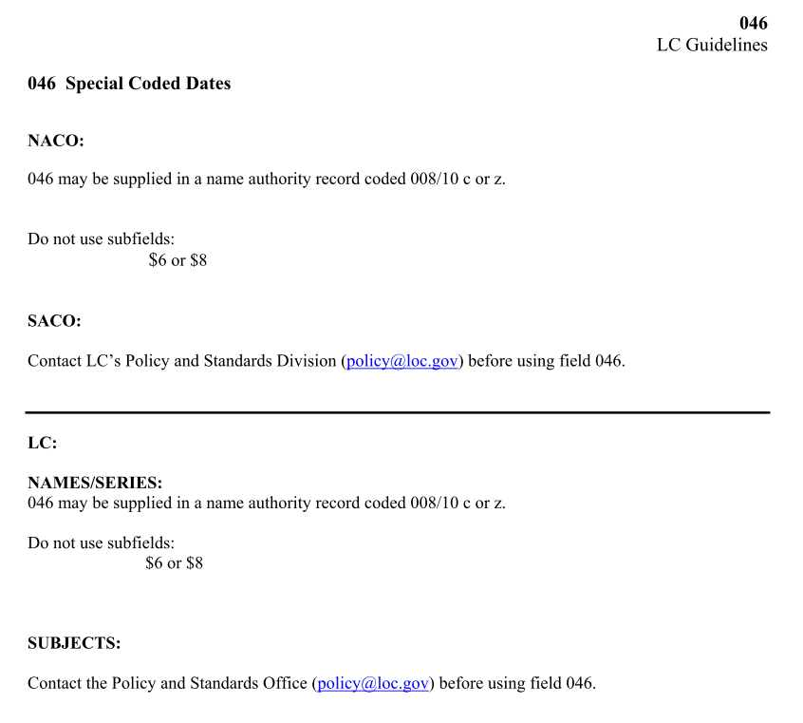
Notes:
And the 046 page from the LC Guidelines Supplement.

Slide 11
Documentation
LC-PCC Policy Statements
Freely available through RDA Toolkit in the “Resources” tab
http://access.rdatoolkit.org/
MARC 21 Encoding to Accommodate New RDA Elements 046 and 3XX in NARs and SARs
http://www.loc.gov/aba/pcc/rda/PCC RDA guidelines/RDA in NARs-SARs_PCC.doc
Notes:
Current Library of Congress-Program for Cooperative Cataloging Policy Statements (LC-PCC PSs) are freely available as part of the RDA Toolkit. Go to access.rdatoolkit.org and click on the "Resources" tab; a license to the Toolkit is not required. This allows fast and easy access through a single source to the most current policy information. Copies of LC-LCC PSs are also available in Cataloger’s Desktop.
The PCC has created a best practices document, “MARC 21 Encoding to Accommodate New RDA Elements 046 and 3XX in NARs and SARs.” It is available on the PCC website and NACO home page.

Slide 12
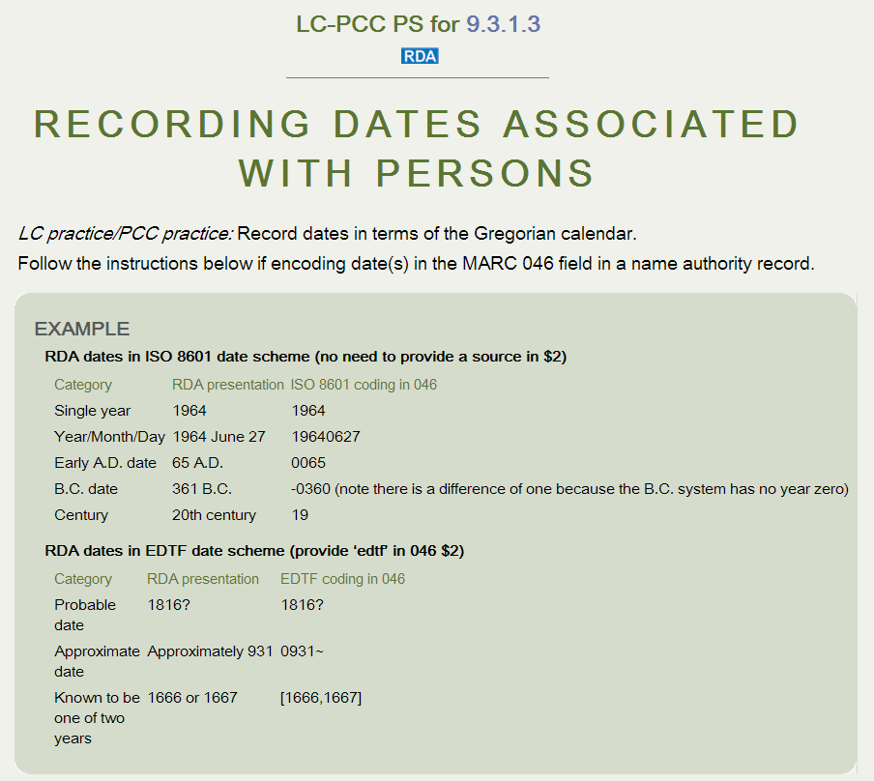

Slide 13
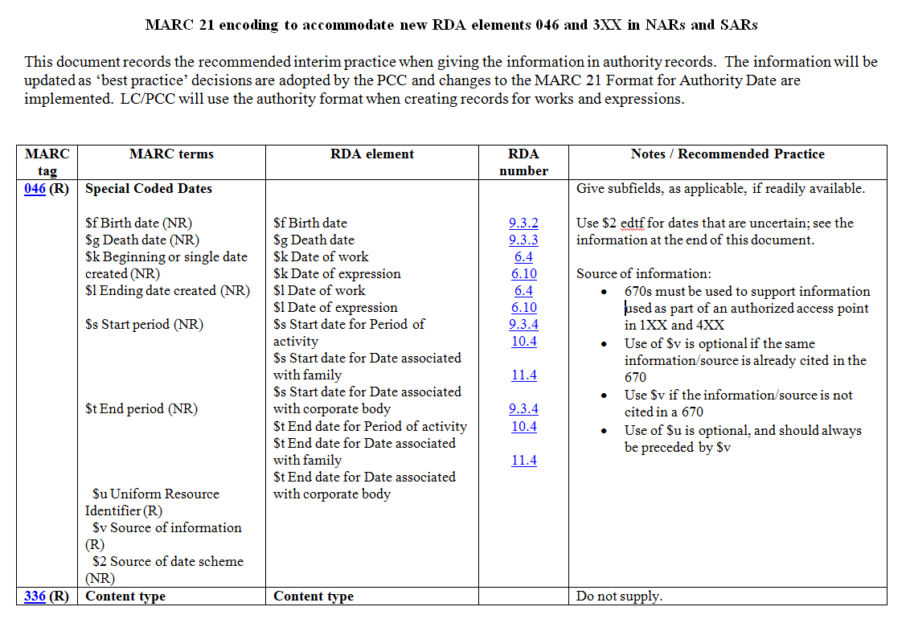

Slide 14
New MARC 21 Authority Fields for RDA
046 - Special Coded Dates
336 - Content Type
368 - Other Attributes of Person or Corporate Body
370 - Associated Place
371 - Address
372 - Field of Activity
373 - Associated Group
374 - Occupation
375 - Gender
376 - Family Information

Slide 15
New MARC 21 Authority Fields for RDA
377 - Associated Language
378 - Fuller Form of Personal Name
380 - Form of Work
381 - Other Distinguishing Characteristic of Work or Expression
382 - Medium of Performance
383 - Numeric Designation of Musical Work
384 - Key
678 - Biographical or Historical Data
*
Notes:
* The 678 is not actually a new field, but it has been given a new life and more use with RDA.

Slide 16
New MARC 21 Authority Fields for Other (Non-RDA) Attributes of Works/Expressions
Established but not yet implemented:
385 - Audience Characteristics
386 - Creator/Contributor Characteristics
Proposed (to be considered at ALA Annual 2014):
388 - Chronological Term Representing Date or Time Period of Creation or Origin of Work/Expression
Notes:
The fields on this slide are new or proposed fields that will be used to record other attributes of works and expressions beyond what is in RDA. These will be used in conjunction with the implementation in 2015 of Library of Congress Genre/Form Terms for music and literature. The 385 and 386 fields will also be used in bibliographic records. The equivalent of the 388 in bibliographic records is the 648 field.

Slide 17

Dates
Many date attributes in RDA
Persons
9.3.2 Date of Birth
9.3.3 Date of Death
9.3.4 Period of Activity of the Person
Families
10.4 Date Associated with the Family
Corporate Bodies
11.4.2 Date of Conference, Etc.
11.4.3 Date of Establishment
11.4.4 Date of Termination
11.4.5 Period of Activity of the Corporate Body

Slide 18
Dates
Works and Expressions
6.4 Date of Work
6.10 Date of Expression
6.20.2 Date of Promulgation of a Law, Etc.
6.20.3 Date of a Treaty
6.24 Date of Expression of a Religious Work

Slide 19
046 - Special Coded Dates
Indicators not defined
Subfields
$f - Birth date (NR)
$g - Death date (NR)
$k - Beginning or single date created (NR)
$l - Ending date created (NR)
$o - Single or starting date for aggregated content (NR)
$p - Ending date for aggregated content (NR)
$s - Start period (NR)
$t - End period (NR)
$u - Uniform Resource Identifier (R)
$v - Source of information (R)
$2 - Source of date scheme (NR)
$6 - Linkage (NR)
$8 - Field link and sequence number (R)

Slide 20
046 - Special Coded Dates
Dates usually recorded according to Representations of Dates and Times (ISO 8601); no $2 used when following ISO 8601
yyyy, yyyy-mm, or yyyymmdd
Year born 1911 $f 1911
Year-Month born April 1911 $f 1911-04
Year-Month-Day born April 15, 1911 $f 19110415
Early A.D. Date born 65 A.D. $f 0065
B.C. Date born 361 B.C. $f -0360
Century active 20th century $s 19
Notes:
For B.C. dates, note there is a difference of one in the coded date because the B.C. system has no year zero

Slide 21
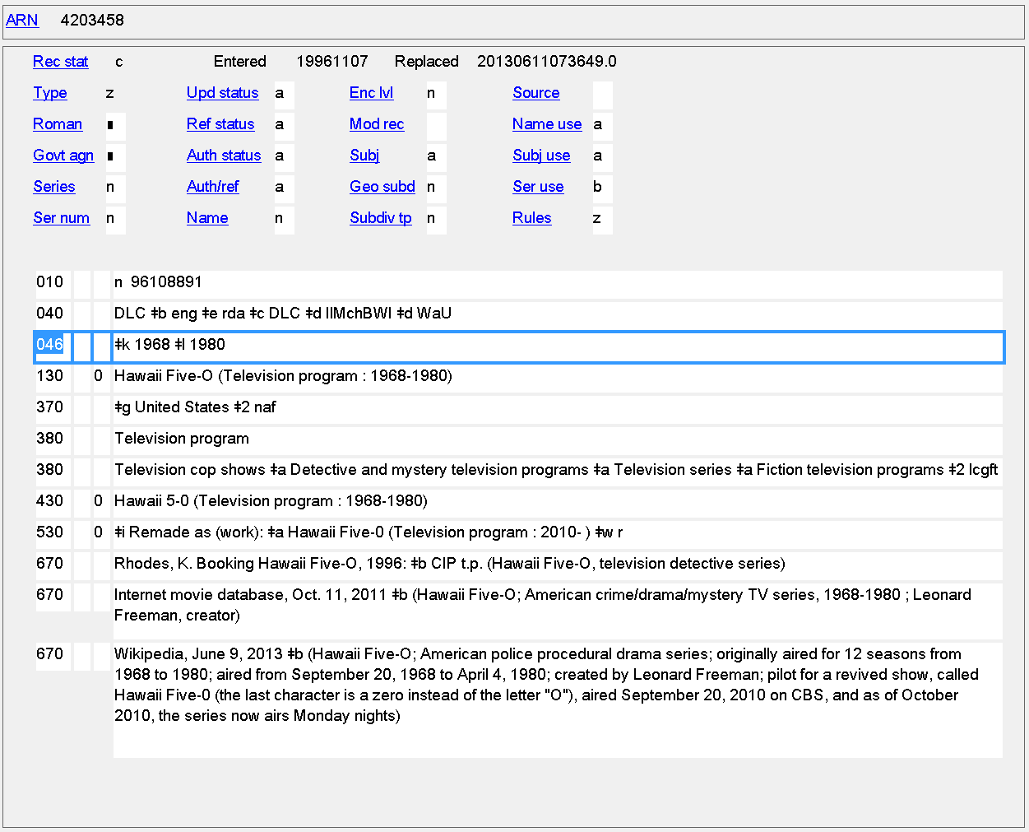
Date of Work
046 $k $l
Notes:
Dates of creation of a work. In this example the dates are part of the authorized access point, and have also been recorded as a separate element.

Slide 22
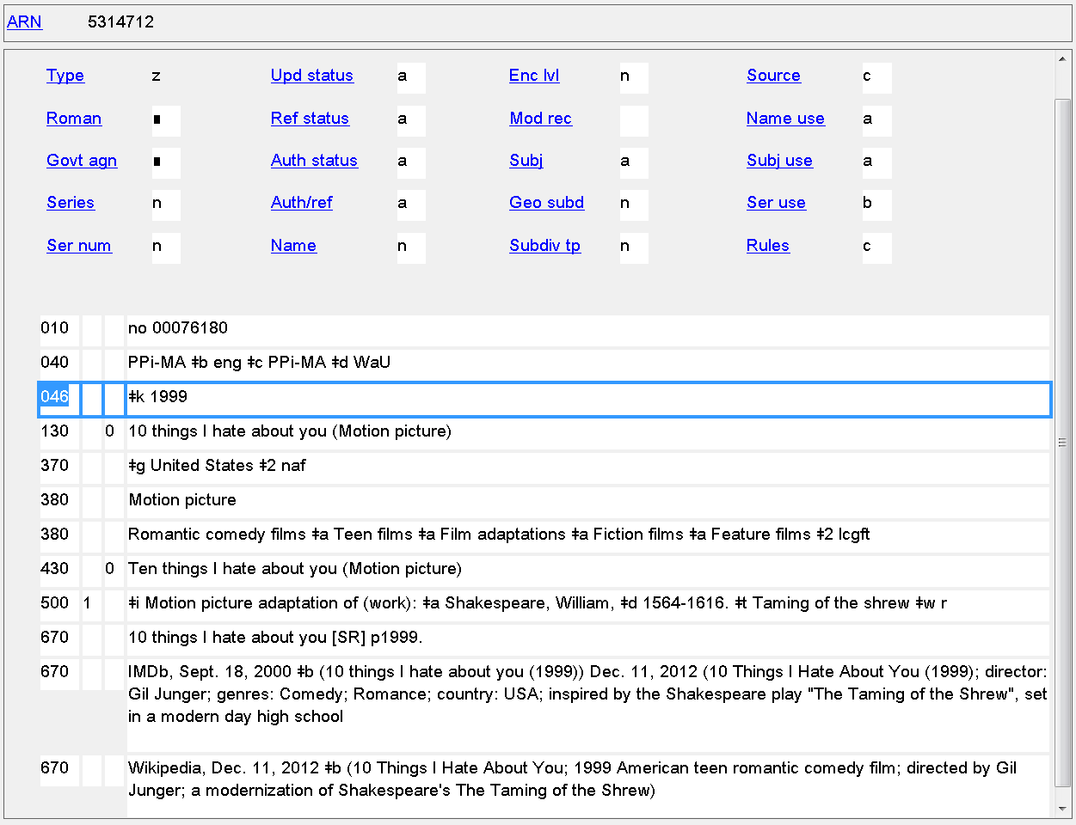
Date of Work
046 $k $l
Notes:
Date(s) of creation of work can be recorded even when the date is not part of the authorized access point.

Slide 23
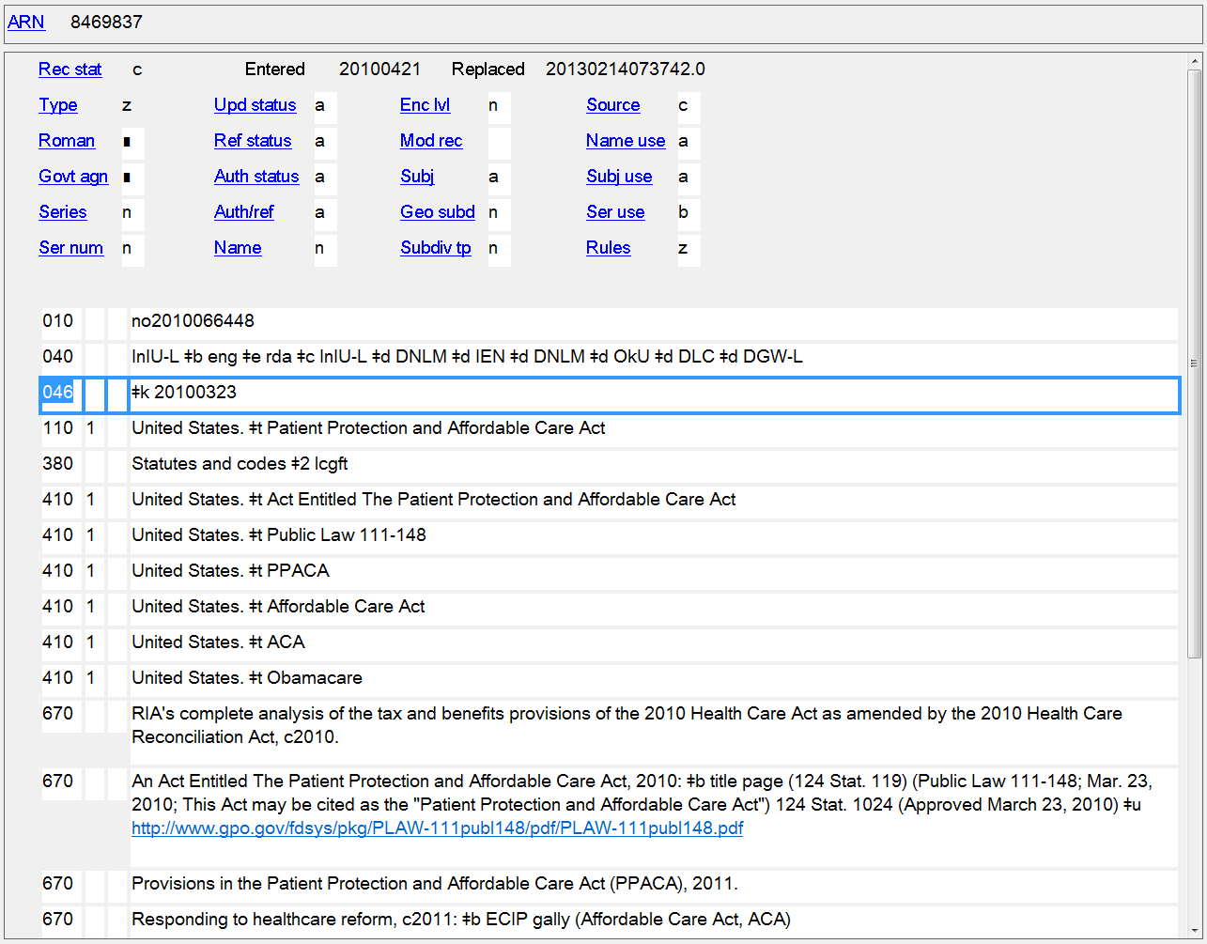
Date of Promulgation of a Law, Etc.
046 $k $l
Notes:
Date of promulgation of the law known as Obamacare.

Slide 24
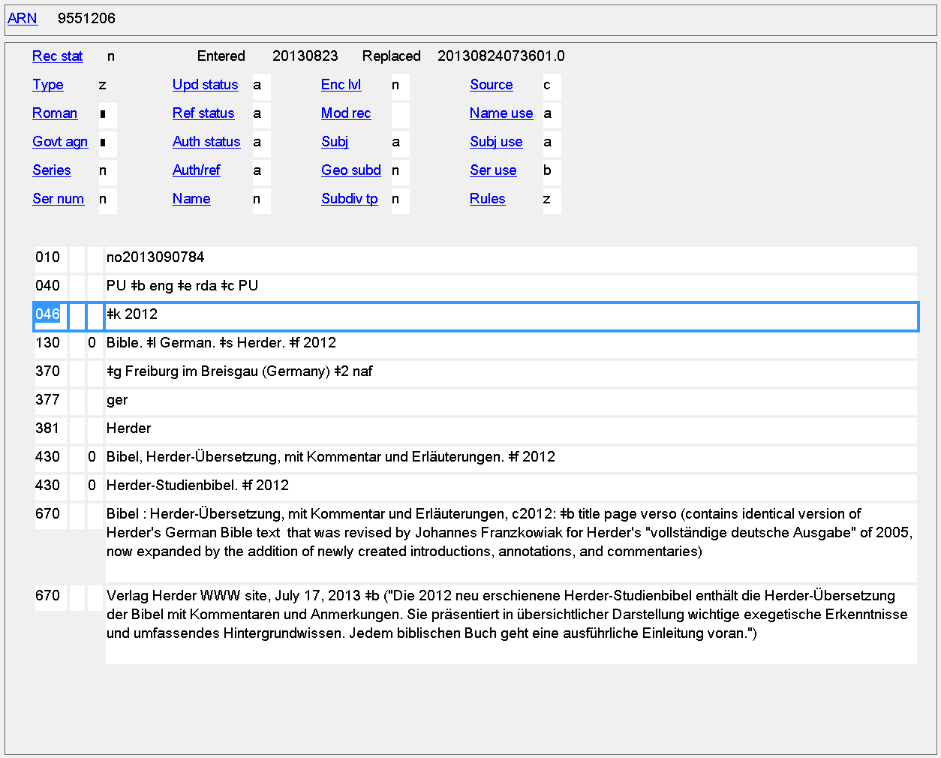
Date of Expression of a Religious Work
046 $k $l
Notes:
Date of expression example. The date here is part of the authorized access point and also recorded separately.

Slide 25
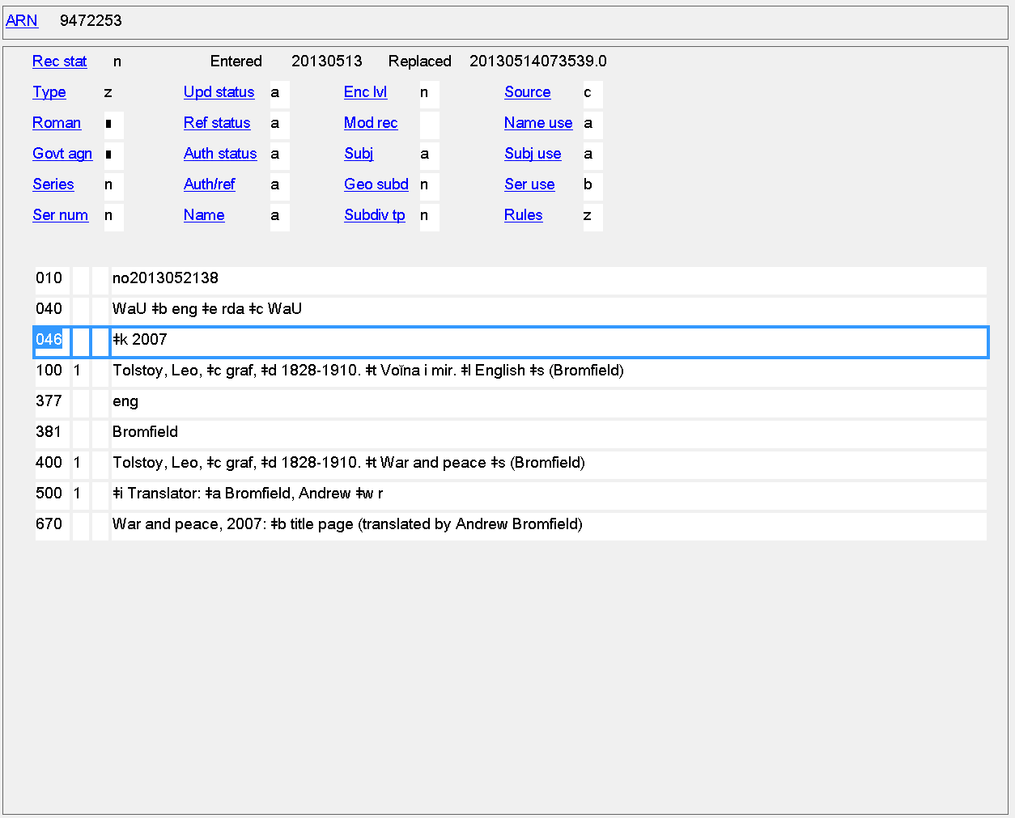
Date of Expression
046 $k $l
Notes:
Date of expression recorded as a separate element even though it’s not in the authorized access point.

Slide 26
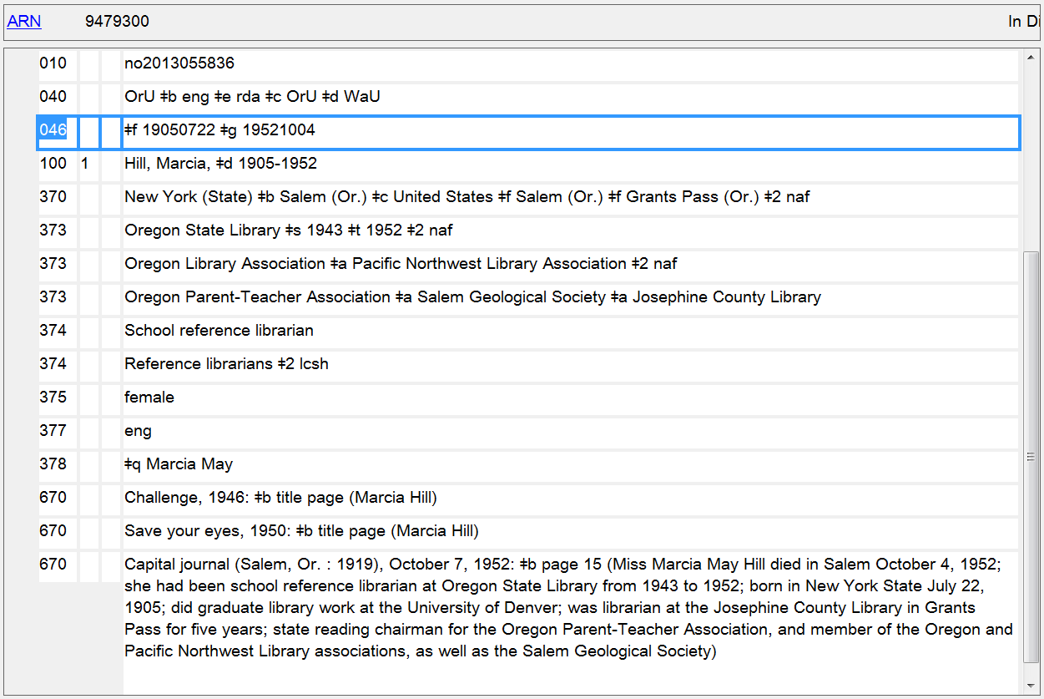
Date of Birth/Date of Death
046 $f $g
Notes:
Dates of birth and death. The 046 will often contain more detailed dates than those found in the authorized access point.

Slide 27
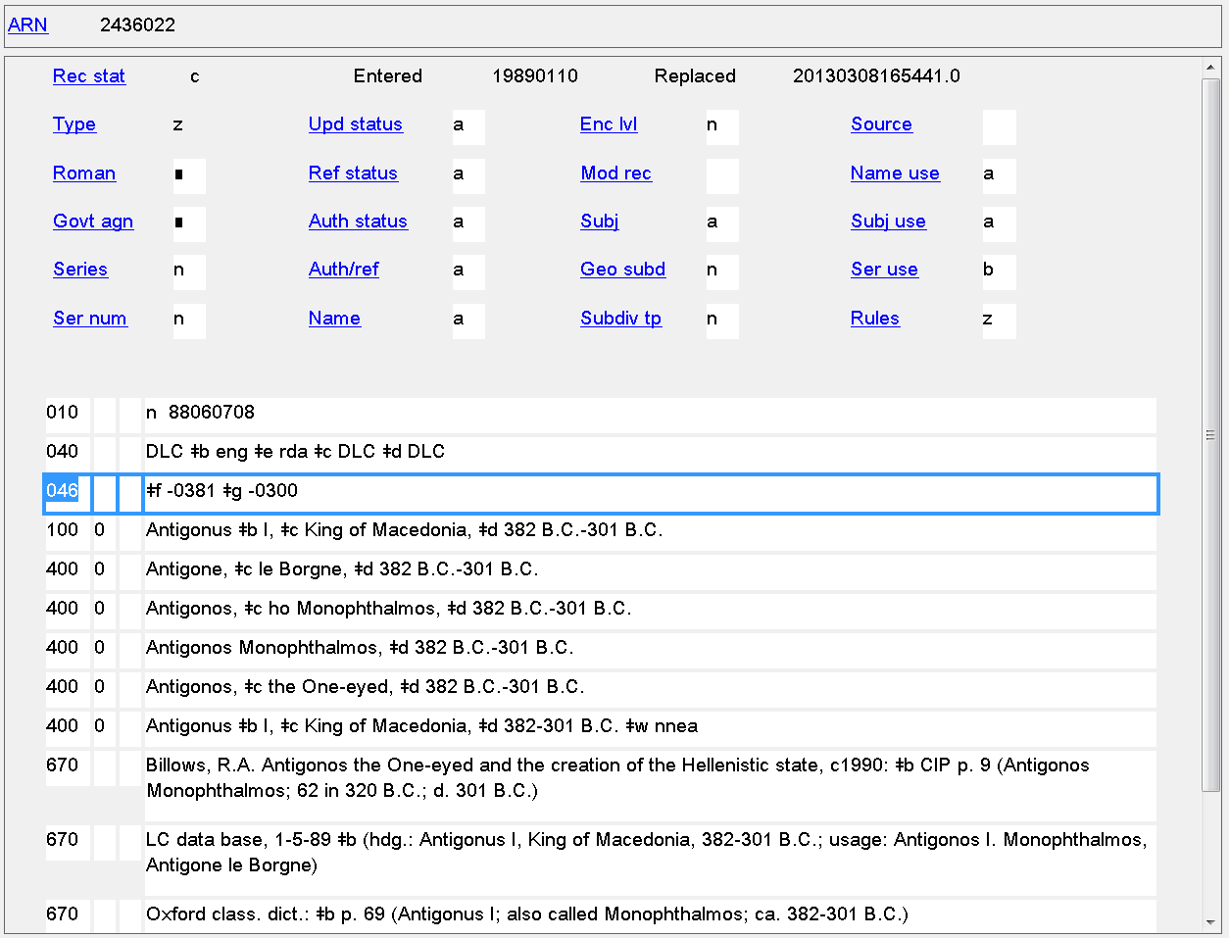
Date of Birth/Date of Death
046 $f $g
Notes:
B.C. dates of birth and death

Slide 28
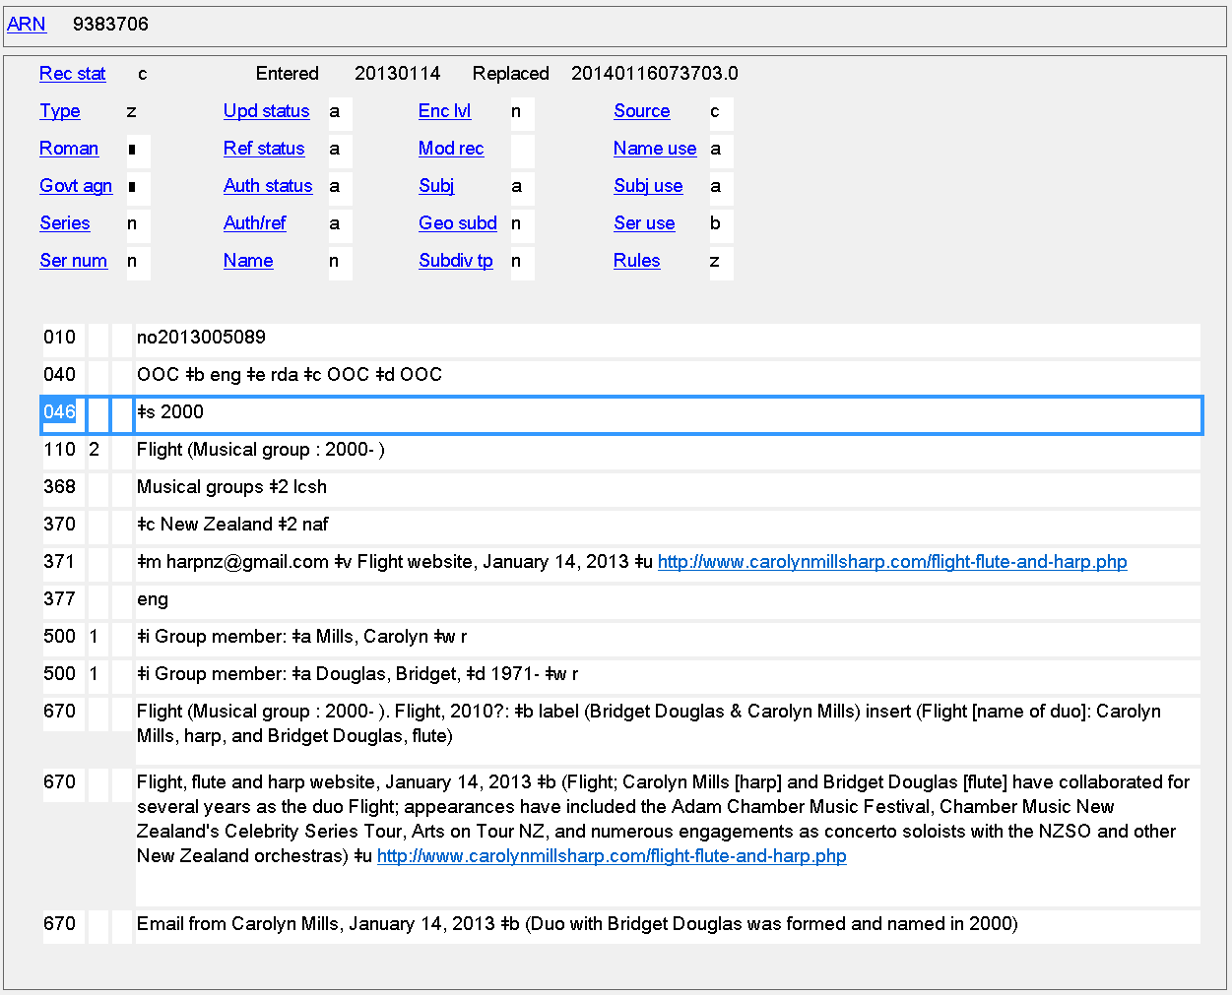
Date of Establishment
046 $s
Notes:
Date of establishment of a musical group. The date is needed in the authorized access point to distinguish this musical group from another with the same name. It has also been recorded as a separate element.

Slide 29
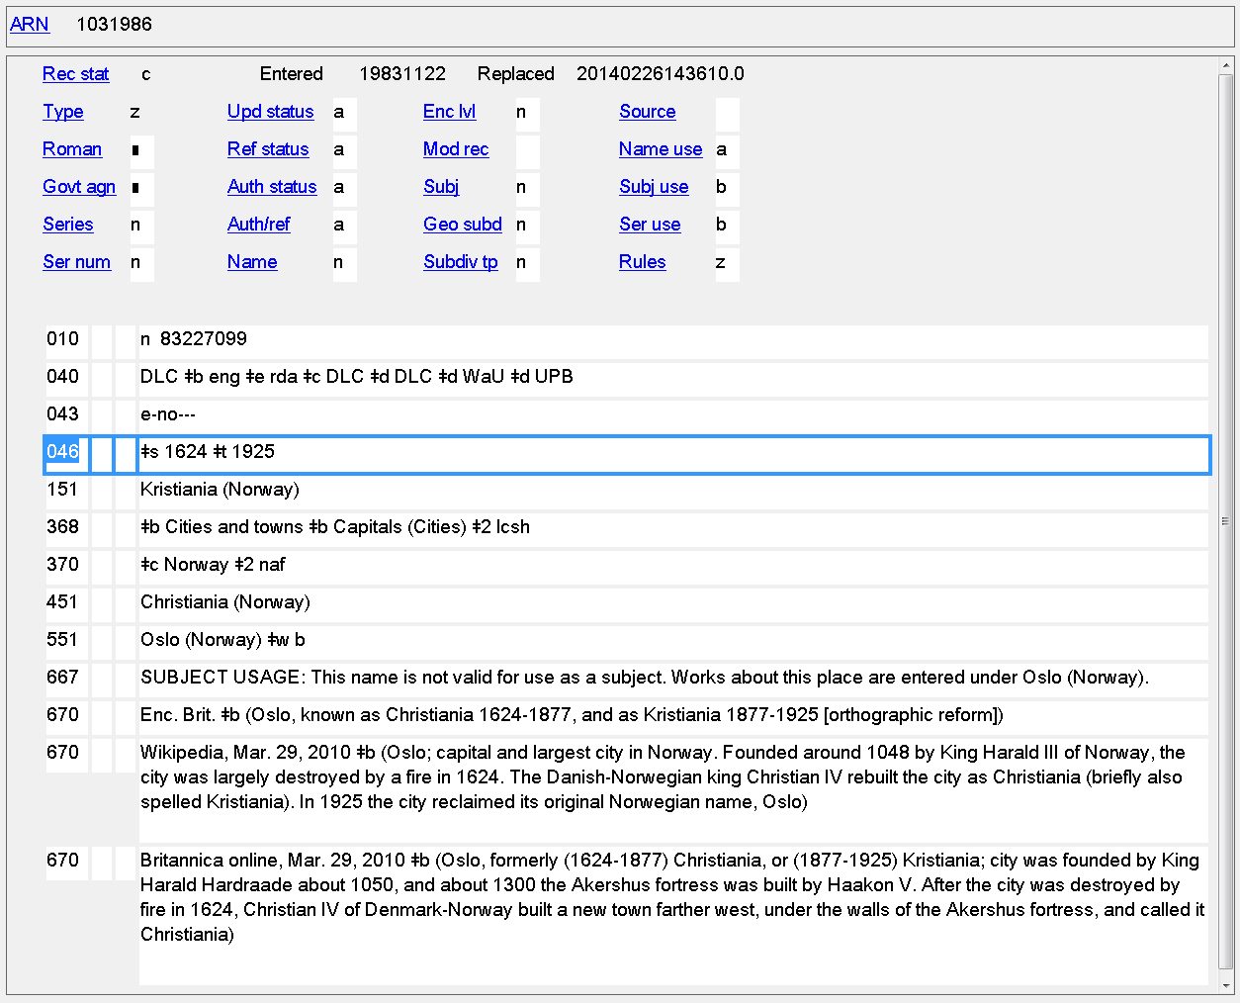
Date of Establishment/Date of Termination
046 $s $t
Notes:
Jurisdiction access points can also have dates of establishment and termination. This example shows a place that changed its name. The dates the earlier name existed are coded in 046 $s and $t.

Slide 30
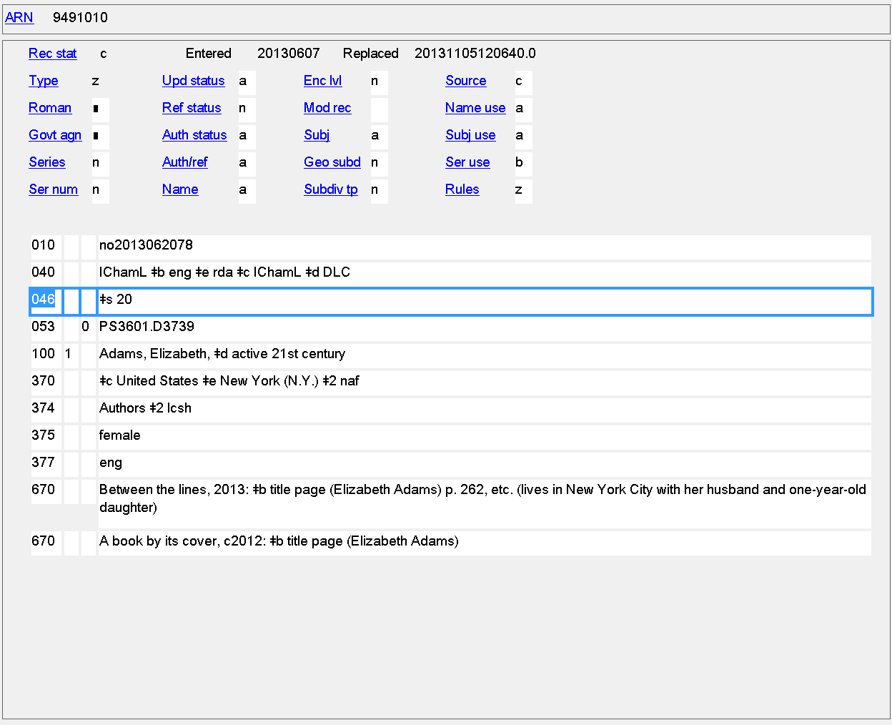
Period of Activity
046 $s $t
active 21st century = 046 $s 20
Notes:
Example of a period of activity. The authorized access point says “active 21st century”, while the coded form of this is $s 20 [i.e., the 2000s].

Slide 31
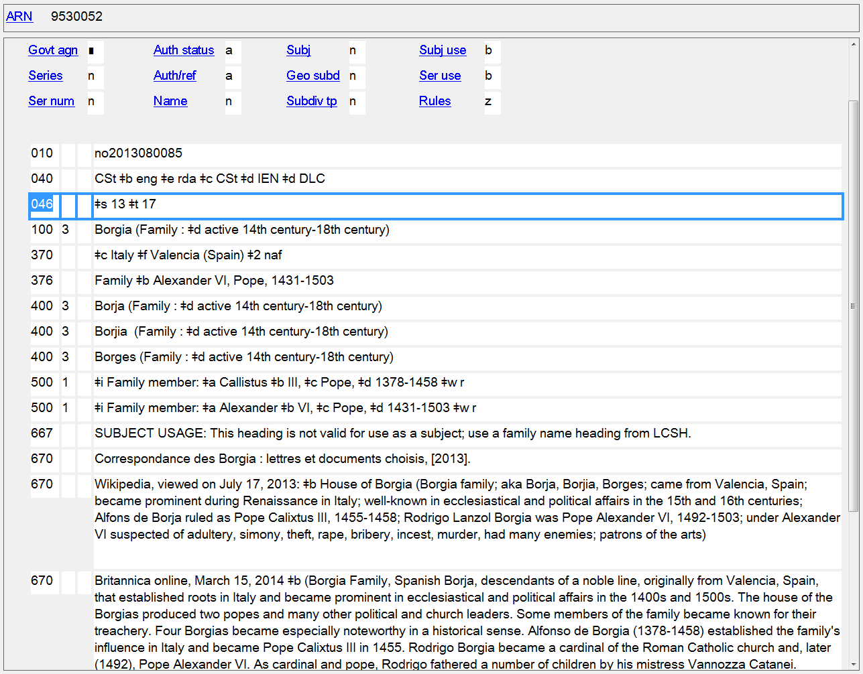
Date Associated with the Family
046 $s $t
Notes:
Period associated with a family.

Slide 32
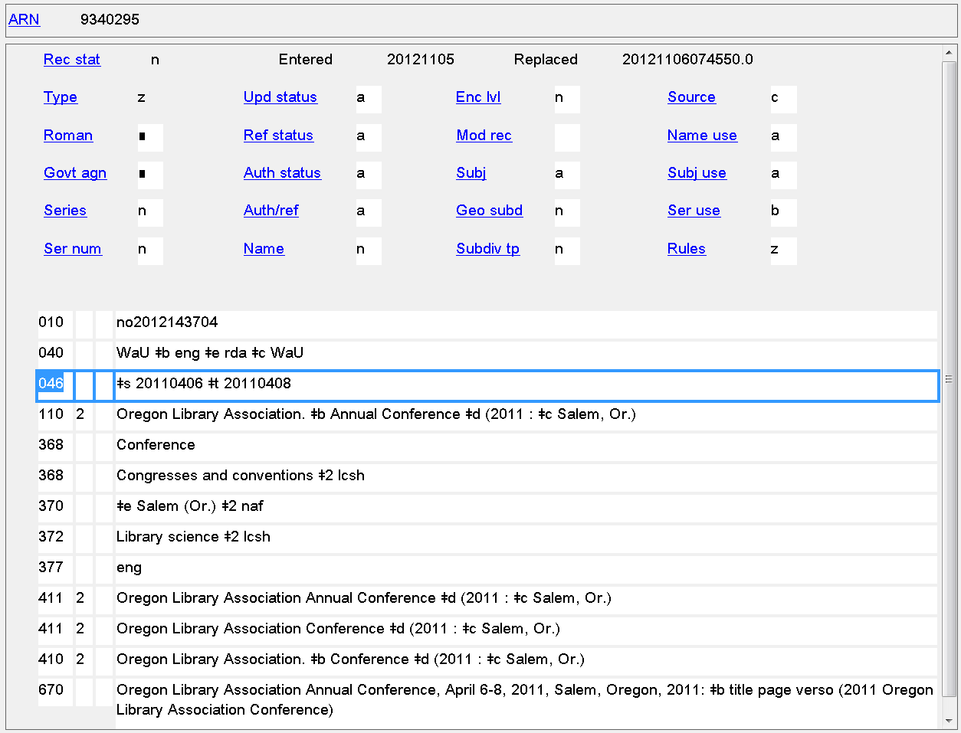
Date of Conference, Etc.
046 $s $t
Notes:
Start and termination dates for a corporate body, in this case a conference.

Slide 33
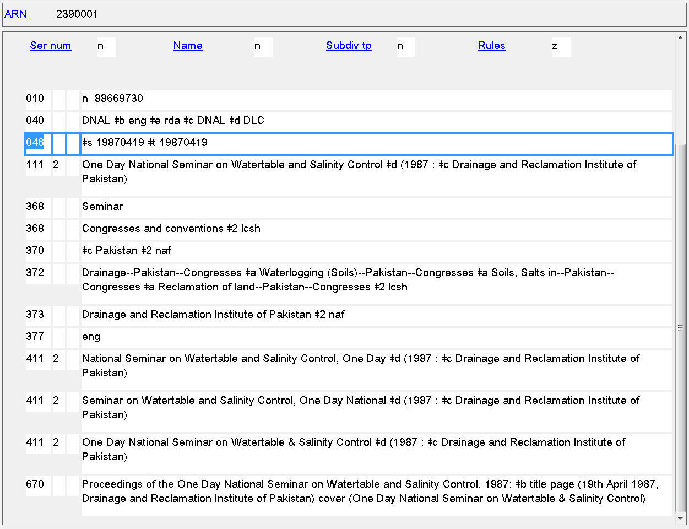
Date of Conference, Etc.
046 $s $t
Notes:
Start and termination dates are identical for an event held on one single day.

Slide 34
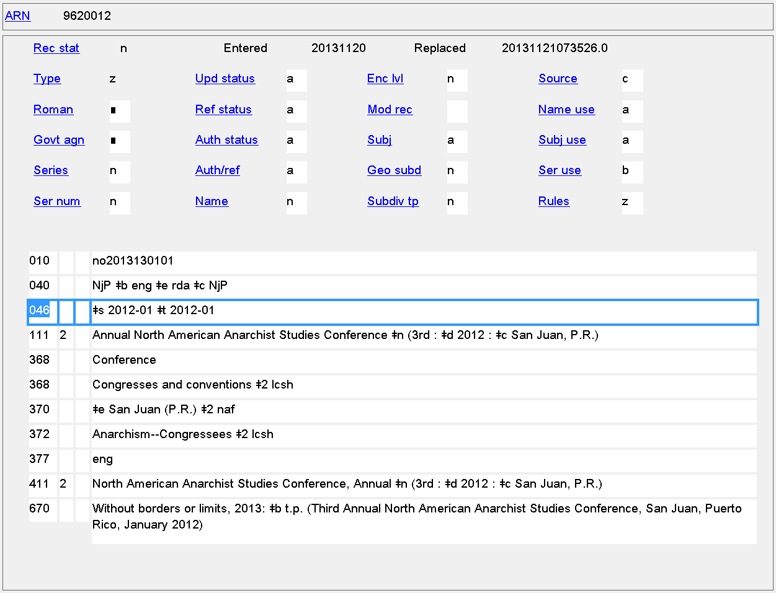
Date of Conference, Etc.
046 $s $t
Notes:
Start and termination dates are identical in this case because all we know is that this conference started and ended in January 2012.

Slide 35
046 - Special Coded Dates
Some types of RDA dates can’t be coded with ISO 8601, e.g.
Probable dates: 1816?
Approximate dates: approximately 931
Date known to be either one of two years: 1666 or 1667
Extended Date-Time Format (EDTF) was created by LC to allow encoding more complex dates
http://www.loc.gov/standards/datetime/

Slide 36
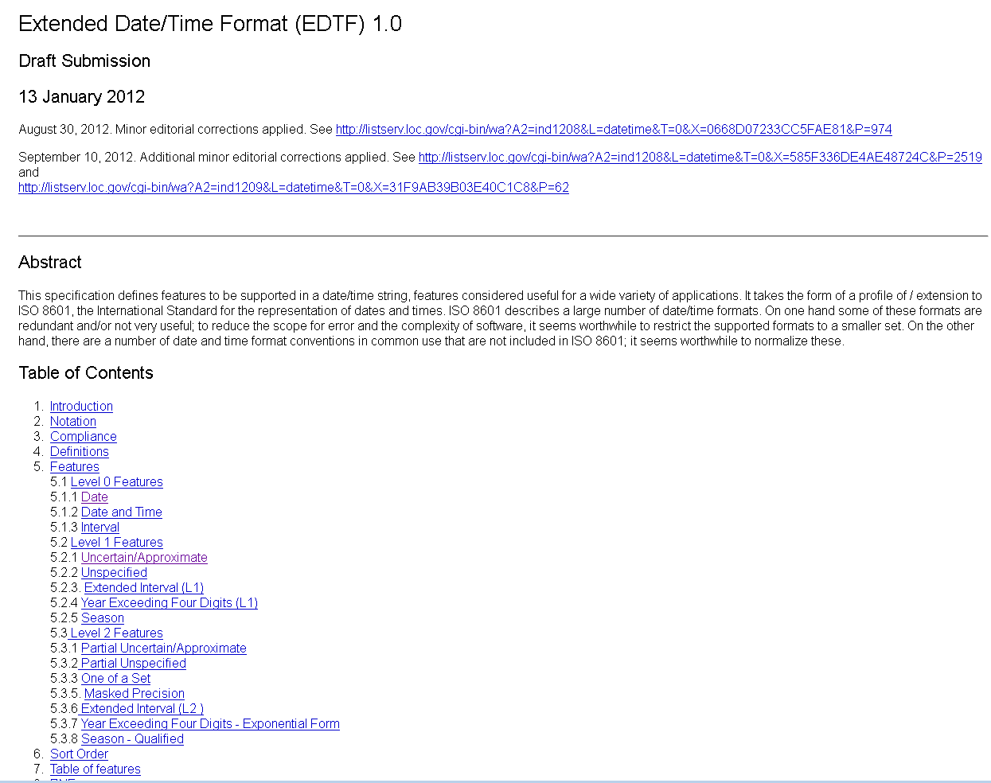
Notes:
Home page for the Extended Date/Time Format (EDTF) specification. Many more kinds of dates can be coded than are called for in RDA (for example, years exceeding four digits, such as might be needed for geological time periods).

Slide 37
046 - Special Coded Dates
In EDTF, the characters ? and ~ are used to mean "uncertain" and "approximate" respectively. These characters may occur only at the end of the date string and apply to the entire date.
Square brackets surrounding two dates separated by a comma are used to mean either one of the two dates.
$2 source code is included in 046 when the standard used is anything other than ISO 8601. For EDTF, use $2 edtf
EXAMPLES
probably born 1848: 046 $f 1848? $2 edtf
born approximately 1848: 046 $f 1848~ $2 edtf
born either 1848 or 1849: 046 $f [1848,1849] $2 edtf

Slide 38
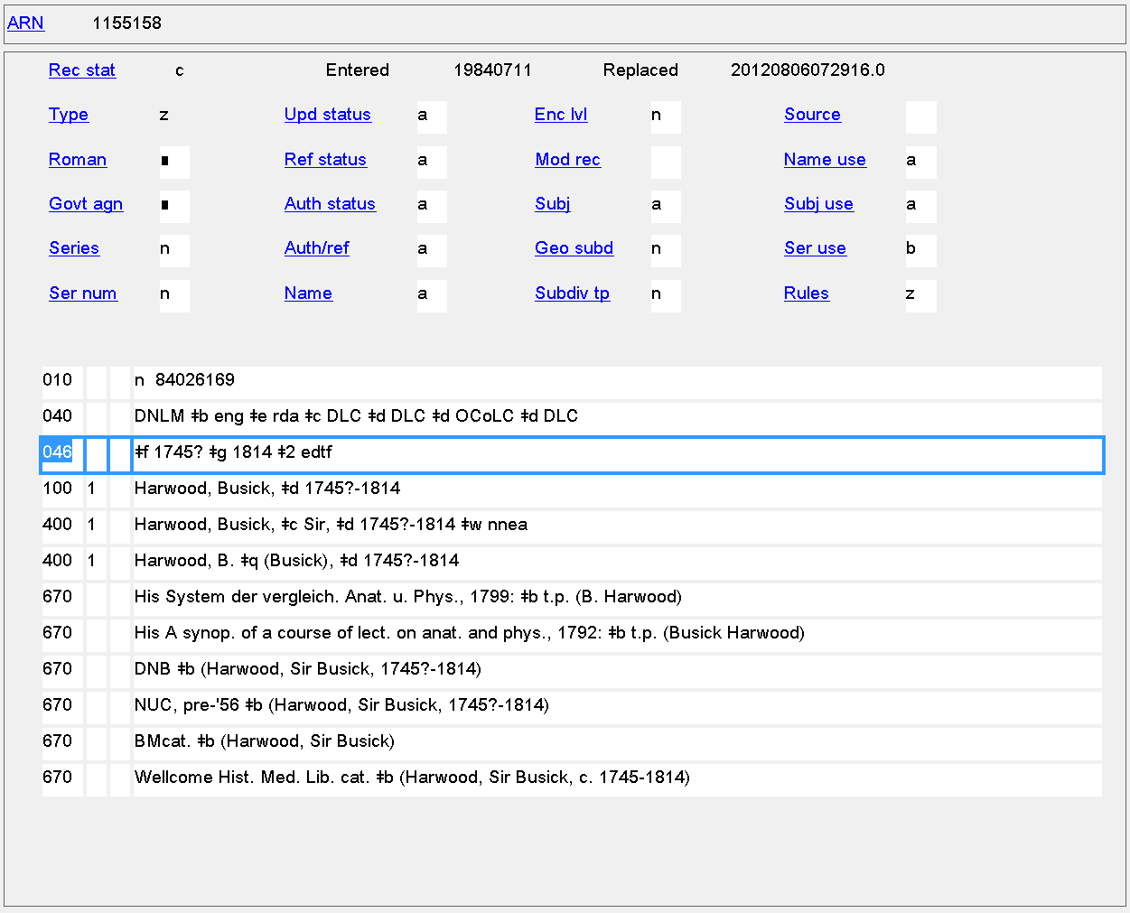
Date of Birth/Date of Death
046 $f $g

Slide 39
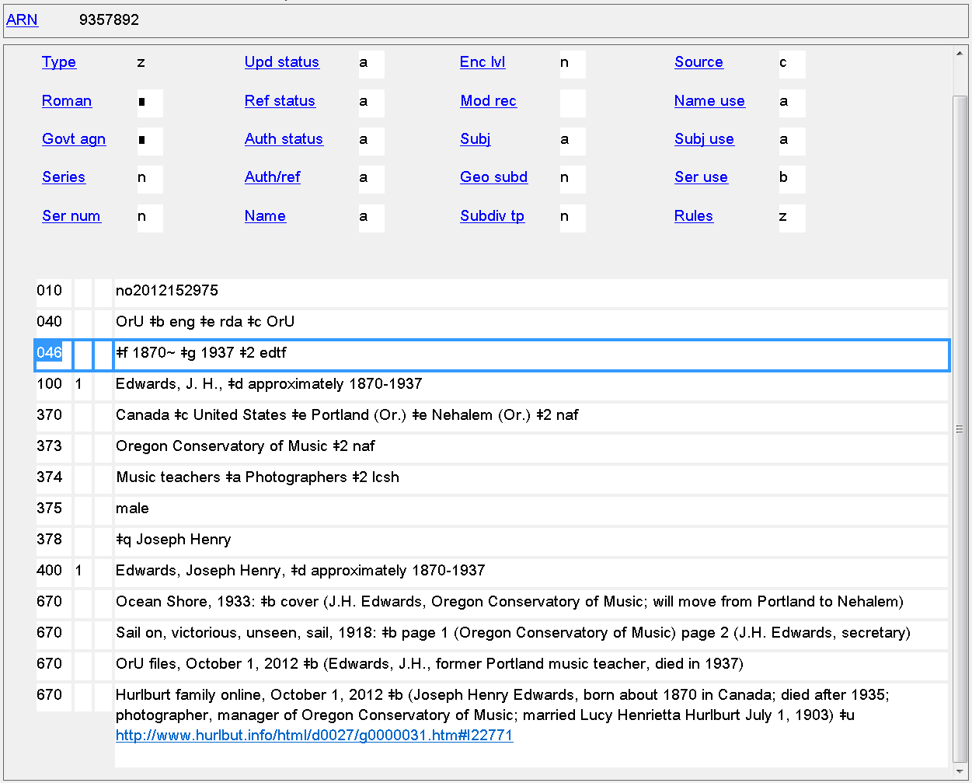
Date of Birth/Date of Death
046 $f $g

Slide 40
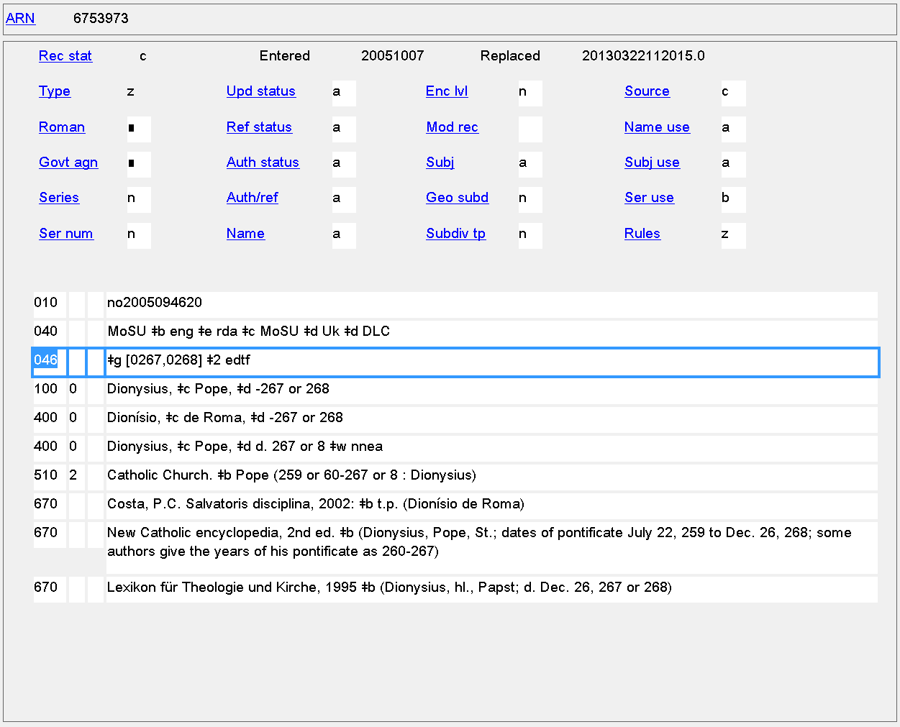
Date of Death
046 $g
Notes:
Only the date of death is known for this person. Note the hyphen in front of the dates in the authorized access point and the presence only of $g (date of death) in the 046 field.

Slide 41
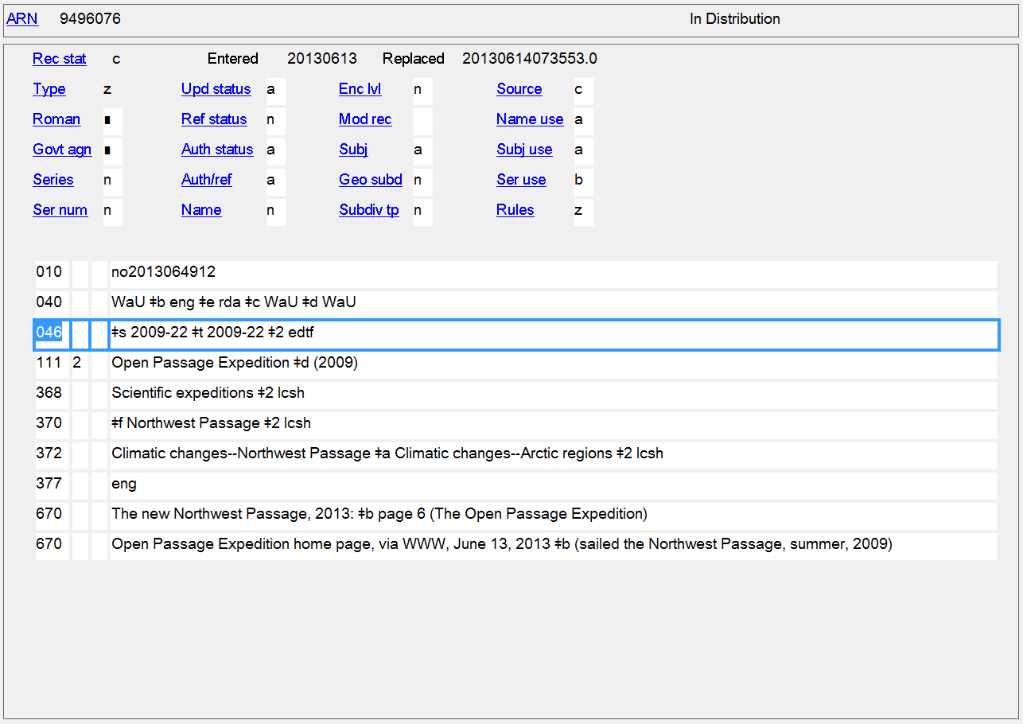
Date of Conference, Etc.
046 $s $t
Notes:
In EDTF, the values 21, 22, 23, 24 may be used used to signify 'Spring', 'Summer', 'Autumn', 'Winter', respectively, in place of a month value (01 through 12) for a year-and-month format string.
Example
2001-21
Spring, 2001

Slide 42
Places
Many place attributes in RDA
Persons
9.8 Place of Birth
9.9 Place of Death
9.10 Country Associated with the Person
9.11 Place of Residence, Etc.
Families
10.5 Place Associated with the Family
Corporate Bodies
11.3.2 Location of Conference, Etc.
11.3.3 Location of Headquarters
Works and Expressions
6.5 Place of Origin of the Work
Notes:
11.3.3 A location of headquarters is a country, state, province, etc., or local place in which an organization has its headquarters.
Alternatively, location of headquarters can be used to record the geographic area (state, province, city, etc.) in which a corporate body carries out its activities.

Slide 43
370 - Associated Place
Indicators not defined
Subfields
$a - Place of birth (NR)
$b - Place of death (NR)
$c - Associated country (R)
$e - Place of residence/headquarters (R)
$f - Other associated place (R)
$g - Place of origin of work (R)
$s - Start period (NR)
$t - End period (NR)
$u - Uniform Resource Identifier (R)
$v - Source of information (R)
$0 - Record control number (R)
$2 - Source of date scheme (NR)
$6 - Linkage (NR)
$8 - Field link and sequence number (R)

Slide 44
370 - Associated Place
RDA: Record the place name as instructed in chapter 16. Abbreviate the names of countries, states, provinces, territories, etc., as instructed in Appendix B (B.11).
16.2.2.4: Precede the name of the larger place by a comma when the place name is used in the following elements:
the location of a conference, etc.
the location of the headquarters of a corporate body
the place of origin of a work
a place associated with a person, family, or corporate body
370 $a Ogden, Ill. $b Corvallis, Or.
Many places recorded in 370s still reflect the RDA instructions, but in 2013 PCC instituted a different policy from RDA
Notes:
RDA tells us to record places in one particular way, and this was followed initially in LC/NACO authority records. However, in 2013 the PCC instituted a policy that is different from what RDA calls for.

Slide 45
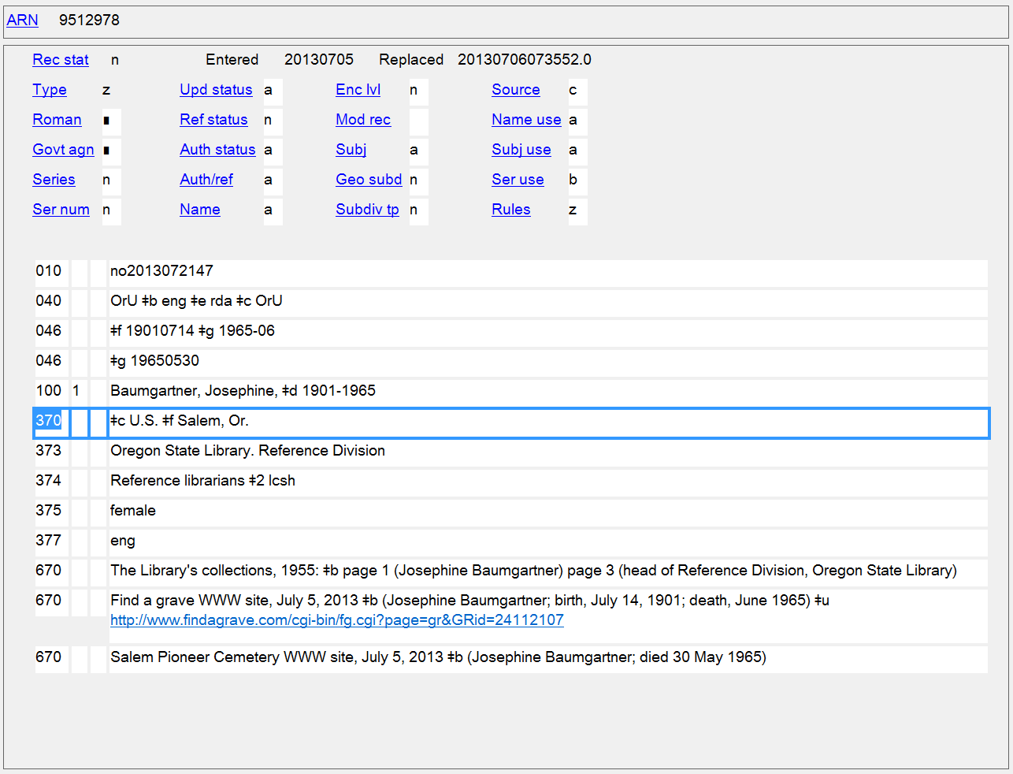
Form of places in this NAR (and many others) reflects RDA instructions. PCC policy now is to use the form exactly as found in the place name authority record.
Notes:
An example of an authority record showing forms of places according to RDA instructions (United States is abbreviated according to Appendix B, and the name of a larger place is put after a comma following the smaller place). There are still many authority records with places recorded this way. PCC changed its policy in 2013.

Slide 46
370 - Associated Place
PCC policies
For jurisdictions or other place names with authority records in the LC/NAF, use the authorized access point form as found
May take non-jurisdictional place names from other controlled vocabulary, e.g. LCSH
Indicate the source of the place name if from a controlled vocabulary, using a $2 code
370 $a Salem (Or.) $c United States $2 naf
370 $g Russia (Federation) $2 naf
370 $b Auschwitz (Concentration camp) $2 naf
370 $e Sauvie Island (Or.) $2 lcsh

Slide 47
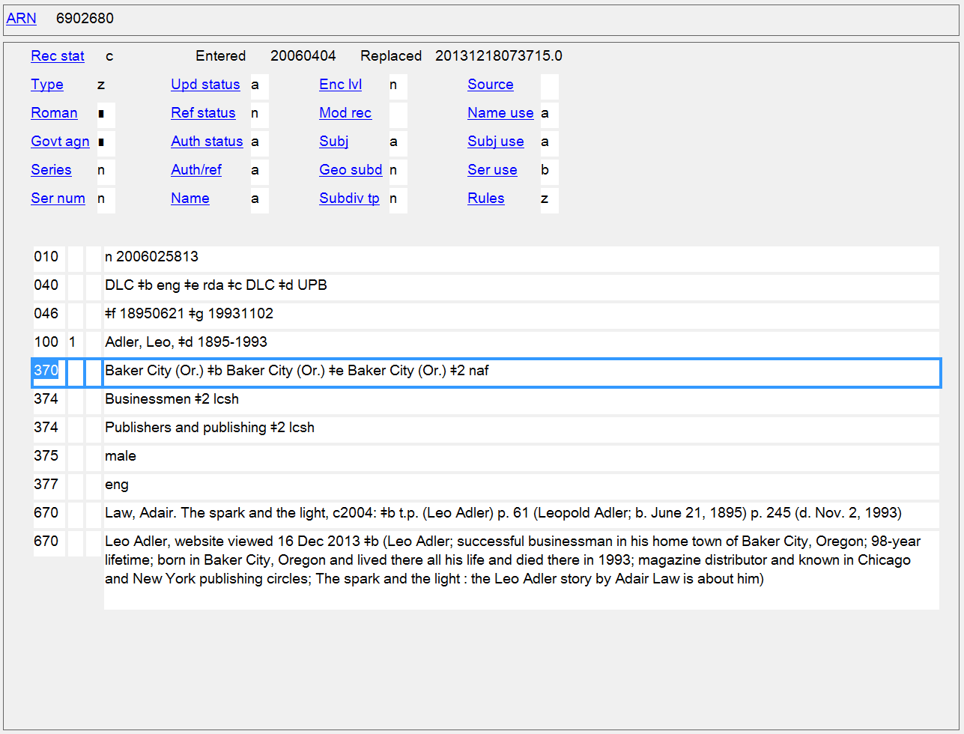
Place of Birth/Place of Death/Place of Residence
370 $a $b $e
Notes:
Baker City has been recorded three times, but each subfield means a different thing, so this isn’t really duplicative.

Slide 48
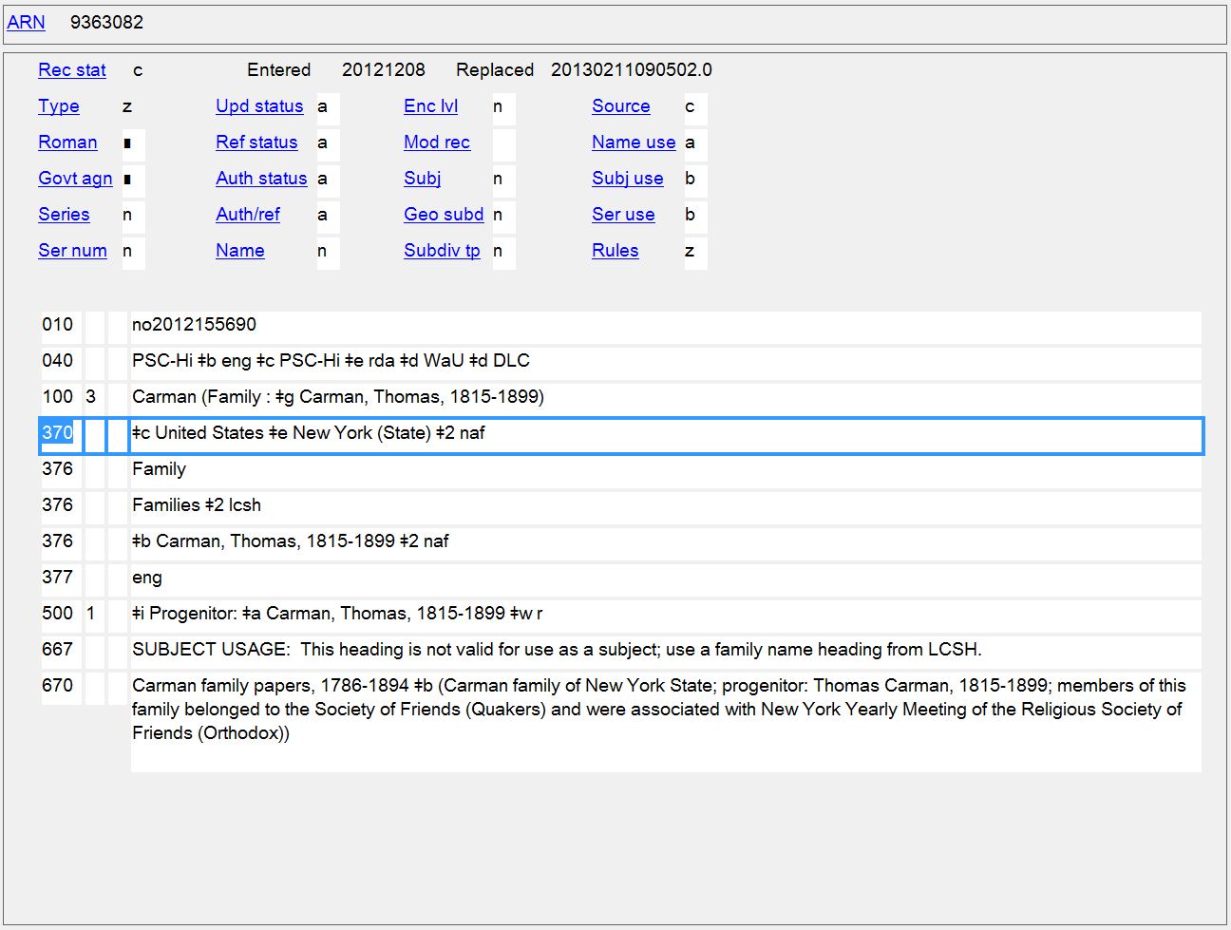
Associated Country/Place of Residence
370 $c $e
Notes:
Associated country and place of residence recorded for a family.

Slide 49
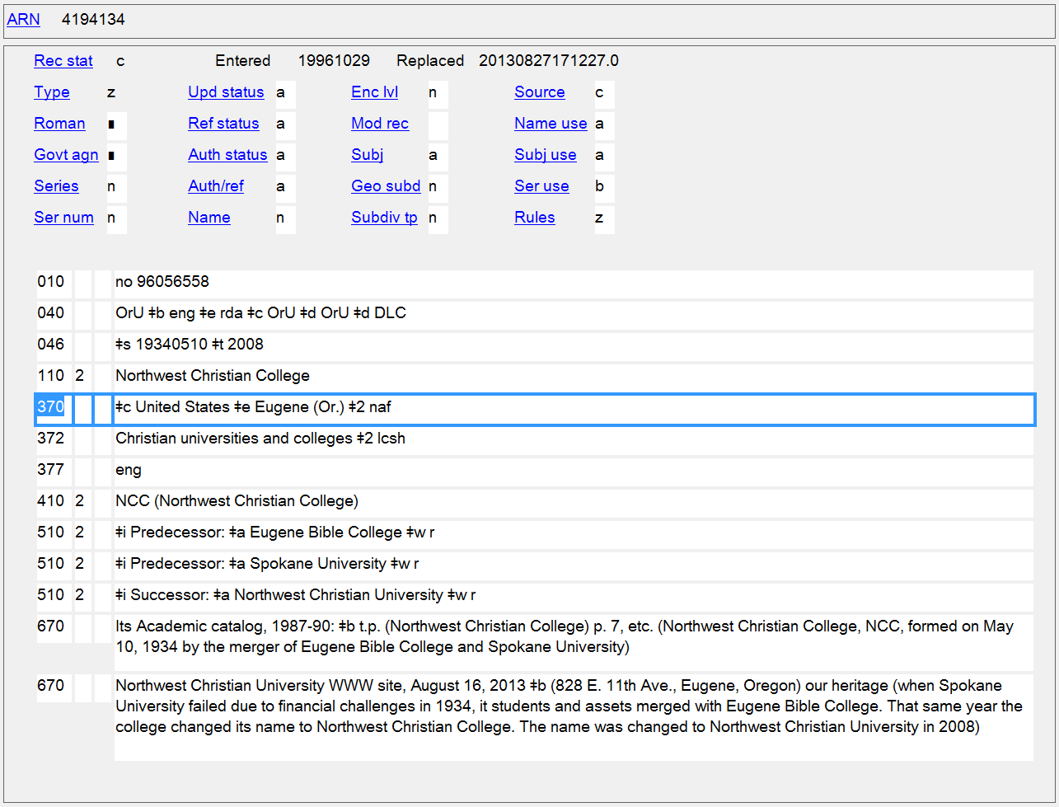
Associated Country/
Location of Headquarters
370 $c $e
Notes:
Associated country and place of headquarters of a corporate body.

Slide 50
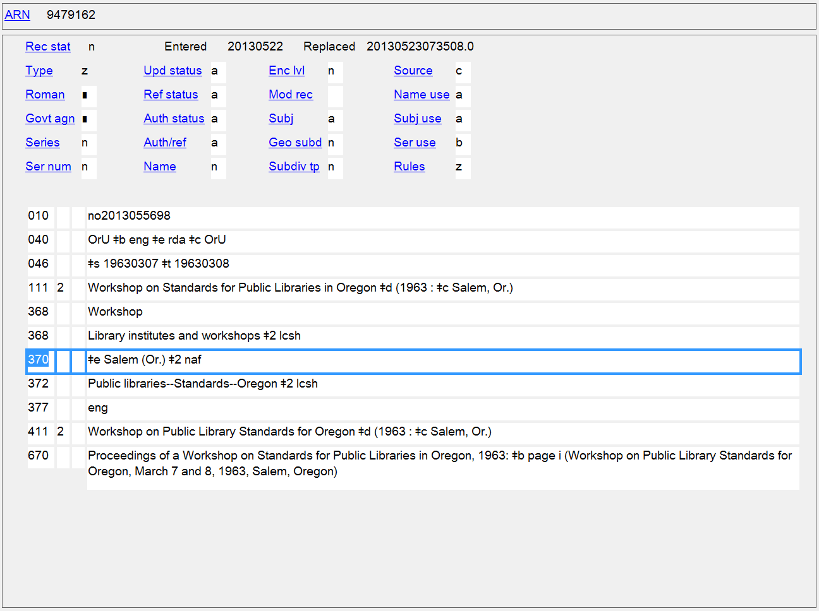
Location of Conference, Etc.
370 $e
Notes:
Location of a conference.

Slide 51
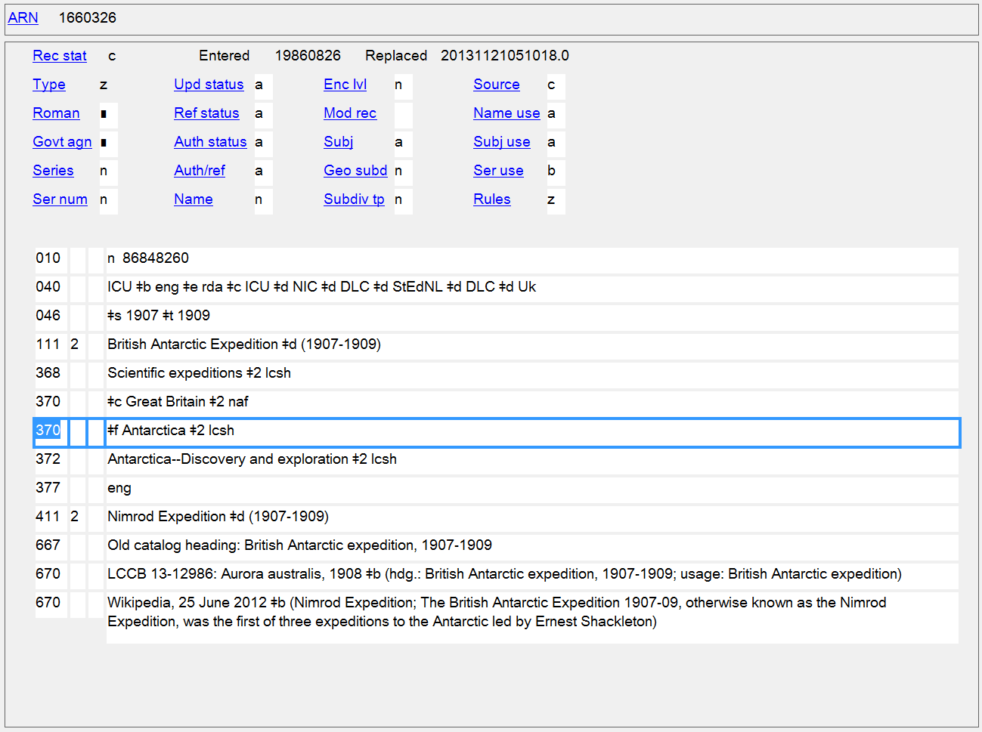
Associated Country/Location of Conference, Etc.
370 $c $f
Notes:
Two locations recorded as separate elements that are not part of the authorized access point for an event. The expedition is associated with the country Great Britain, but took place in Antarctica. $f is used for associated places that don’t fit into any of the other MARC subfields. Since Antarctica is not a jurisdiction, the subfield $2 in the 370 shows that it was taken from the controlled vocabulary LCSH.

Slide 52
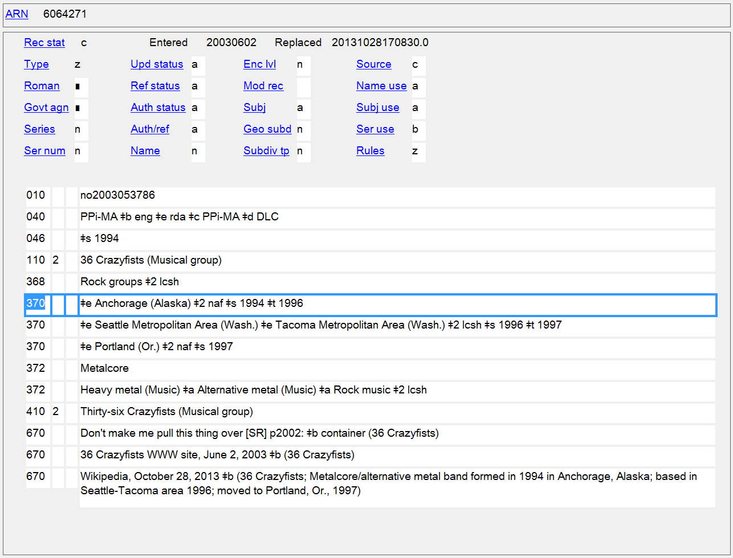
Locations of Headquarters with associated dates
370 $e $s $t
Notes:
Example shows the use of dates to indicate what time period the data recorded applies to. The rock group here was first based in Anchorage from 1994-1996, then moved to the Seattle-Tacoma area in 1996, and then to Portland, Oregon in 1997. The second 370 shows headings formulated according to LCSH, and also shows that headings/terms from the same controlled vocabulary can be recorded in one field in repeatable subfield $a’s.

Slide 53
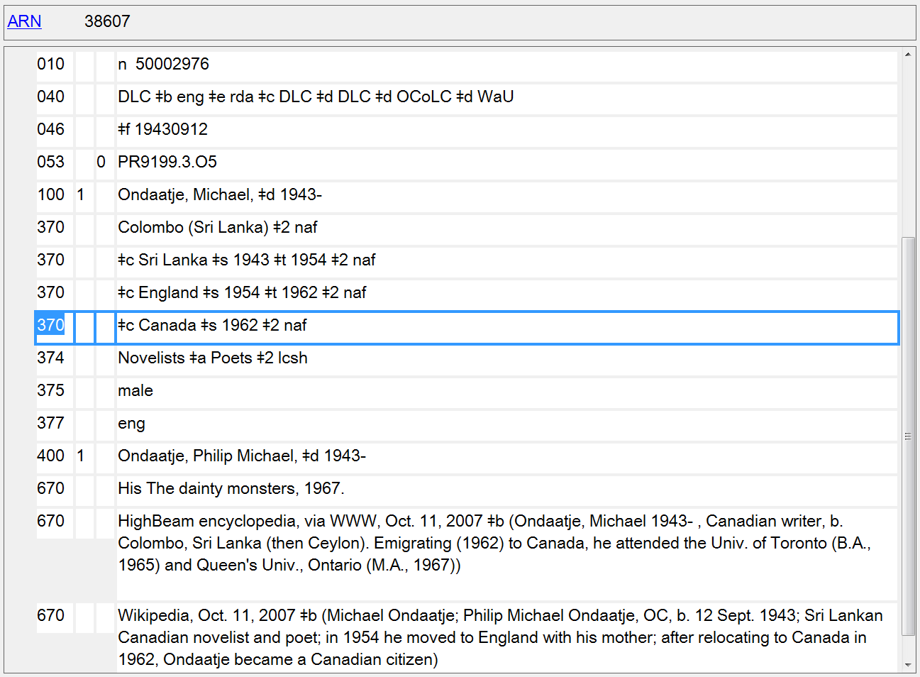
Place of Birth/Associated Countries with associated dates
370 $a $c $s $t
Notes:
Michael Ondaatje was born in Colombo, Sri Lanka (first 370). Three different associated countries are recorded with dates pertinent to each.

Slide 54
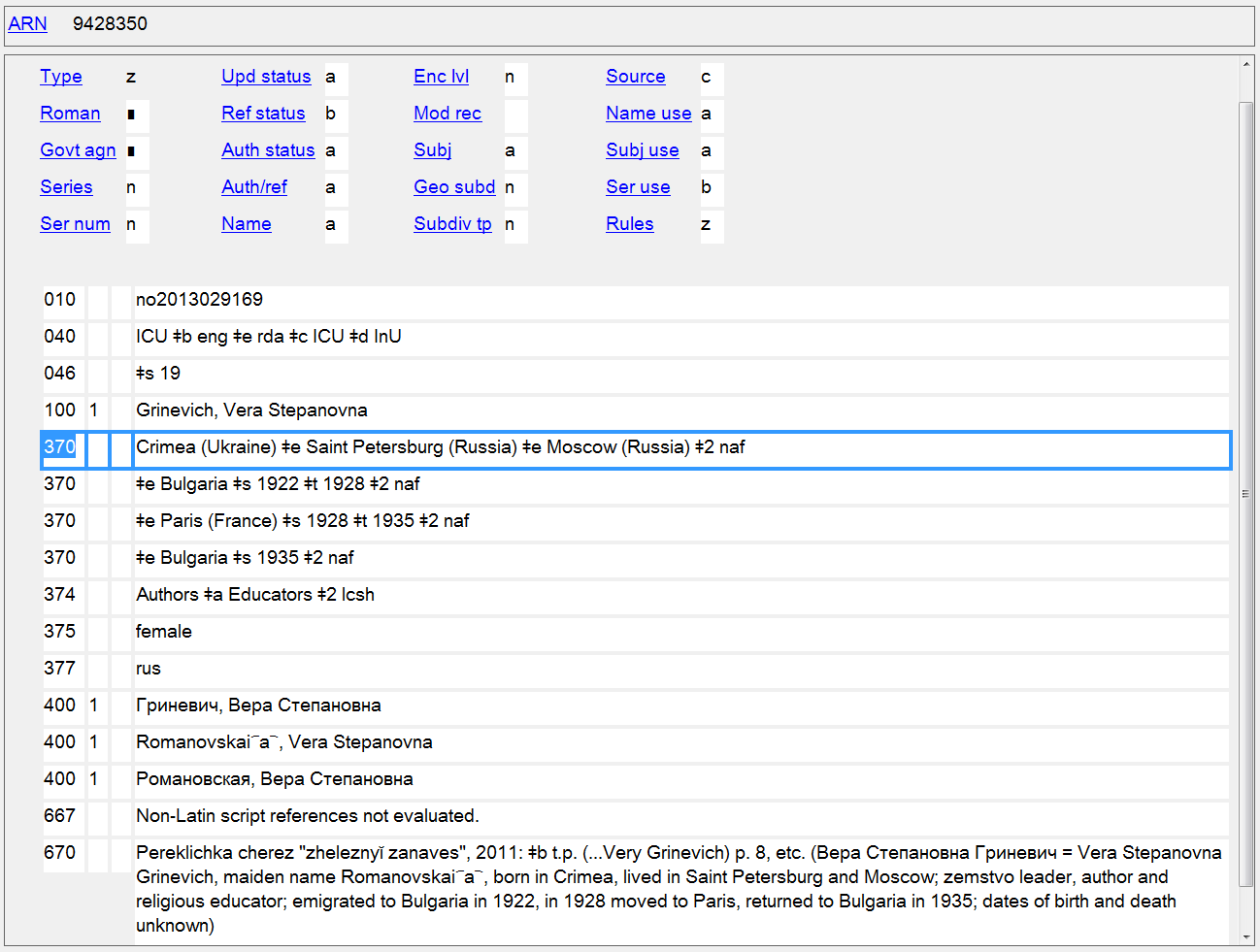
Place of Birth/Places of Residence, with associated dates when known
370 $a $e $s $t
Notes:
In this case, the first 370 shows two places where this person lived but for which specific dates are not available. Then three more 370s fields show a place of residence with associated dates. Two of these have the same place (Bulgaria), but because the dates don’t overlap, separate fields are needed.

Slide 55
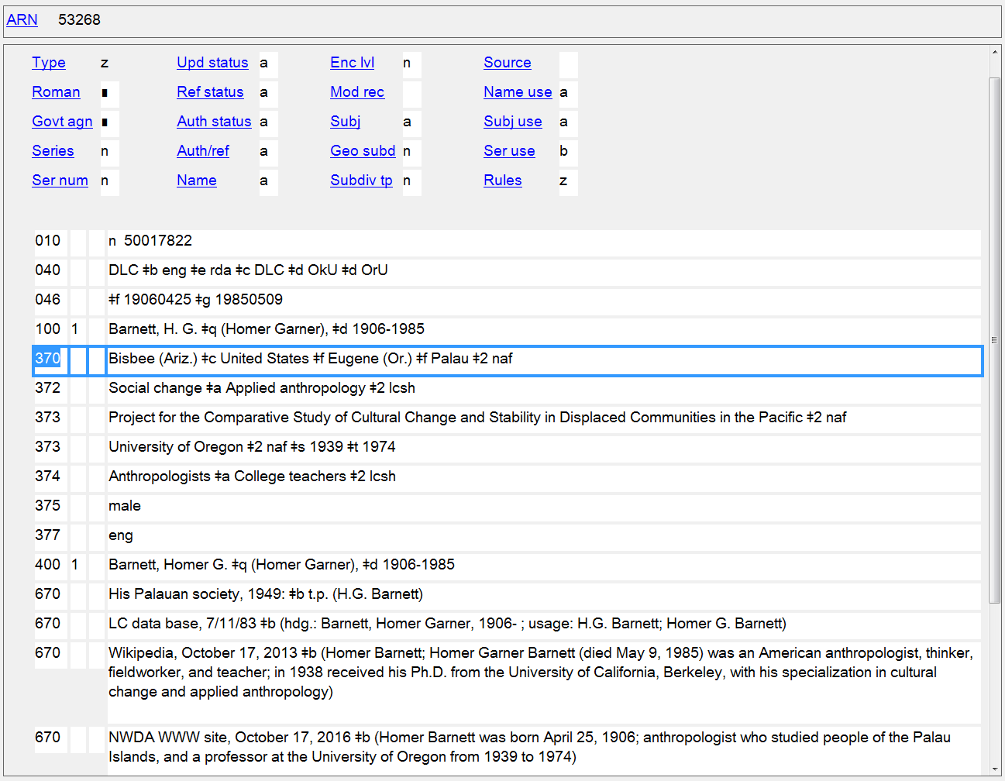
Place of Birth/Associated Country/Other Associated Places
370 $a $c $f
Notes:
$f - Other associated place
For persons, this is used for any place associated with a person other than place of birth, place of death, or residence. It’s commonly used to record a place where a person worked or studied.
9.11.1.1 Place of residence, etc., is a town, city, province, state, and/or country in which a person resides or has resided, or another significant place associated with the person other than place of birth, place of death, or residence (e.g., a place where a person has worked or studied).
The person did field work in Palau. This was recorded in $f, but perhaps could have been put in $c (associated country) instead.

Slide 56
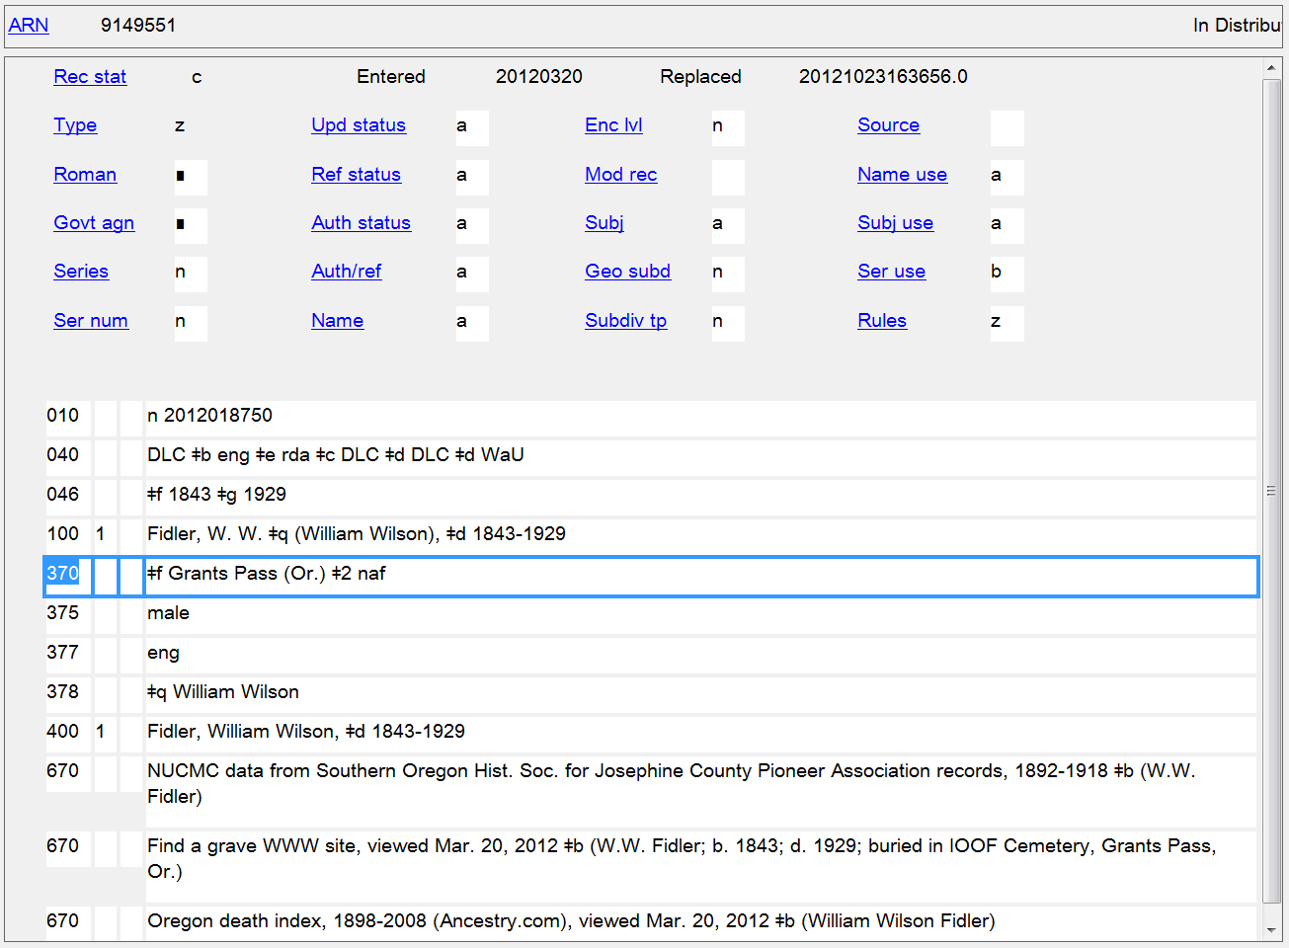
Other Associated Place (Burial Place)
370 $f
Notes:
Burial places, and other places that don’t fit into any of the more narrowly defined subfields (e.g., place where the person worked, place where they attended school) are coded in $f.

Slide 57
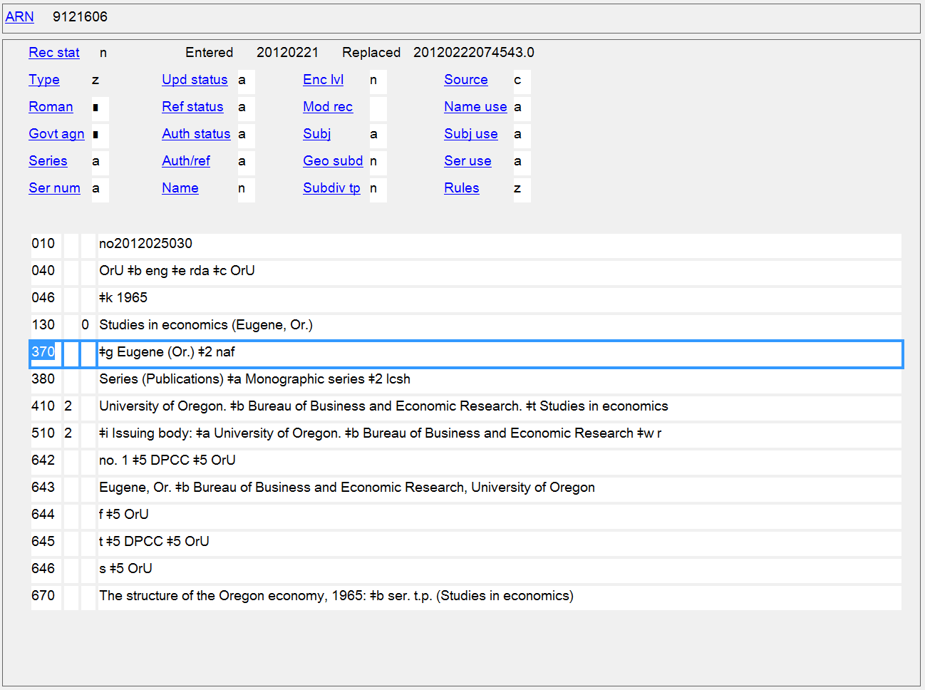
Place of Origin of Work
370 $g
Notes:
Place of origin of work included in authorized access point for work as well as recorded separately.

Slide 58
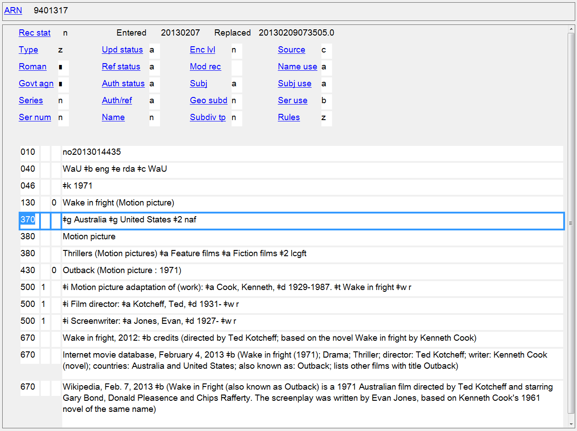
Places of Origin of Work
370 $g
Notes:
Places of origin of work recorded separately even though not needed as part of the authorized access point.

Slide 59
Address
Persons
9.12 Address of the Person
Families
Nothing in RDA
Corporate Bodies
11.9 Address of the Corporate Body

Slide 60
371 - Address
Indicators not defined
Subfields
$a - Address (R)
$b - City (NR)
$c - Intermediate jurisdiction (NR)
$d - Country (NR)
$e - Postal code (NR)
$m - Electronic mail address (R)
$s - Start period (NR)
$t - End period (NR)
$u - Uniform Resource Identifier (R)
$v - Source of information (R)
$z - Public note (R)
$4 - Relator code (R)
$6 - Linkage (NR)
$8 - Field link and sequence number (R)

Slide 61
371 - Address
PCC best practices
Supply based on cataloger's judgment, if the information is readily available and not already being recorded in field 370 subfield $e (Place of residence/headquarters).
An address should have at a minimum a city ($b) or email ($m) present. Prefer field 370 $c if only a country is available.
Do not record physical addresses for living people.
Catalogers are not required to maintain address information when updating a record that contains an address.
Subfield $m should contain only an e-mail address. Do not add an internet address for the 1XX in this field

Slide 62
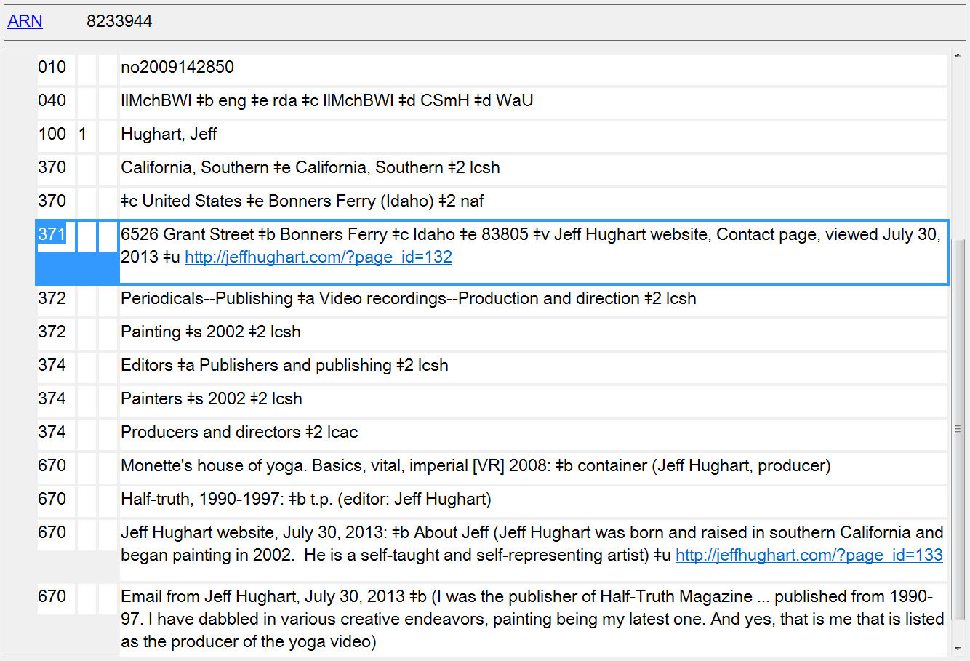
Address of the Person
371
Notes:
Despite PCC best practice of not recording addresses for living persons, many records, like this one, have it.

Slide 63
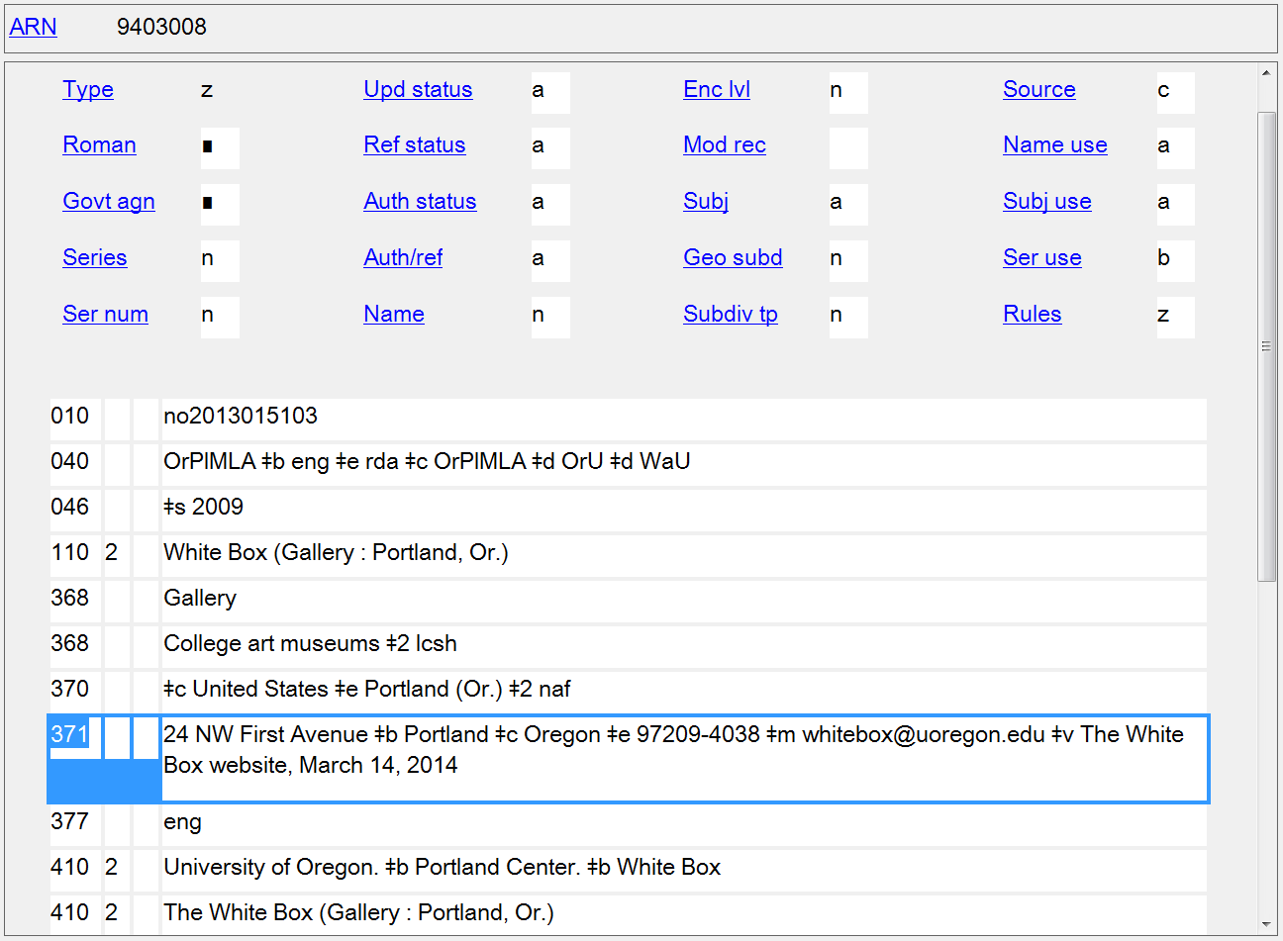
Address of the Corporate Body
371

Slide 64
Field of Activity
Persons
9.15 Field of Activity of the Person
Corporate Bodies
11.10 Field of Activity of the Corporate Body

Slide 65
372 - Field of Activity
Indicators not defined
Subfields
$a - Field of activity (R)
$s - Start period (NR)
$t - End period (NR)
$u - Uniform Resource Identifier (R)
$v - Source of information (R)
$0 - Record control number (R)
$2 - Source of term (NR)
$6 - Linkage (NR)
$8 - Field link and sequence number (R)

Slide 66
372 - Field of Activity
PCC policies
Prefer controlled vocabulary, such as LCSH or MeSH, recording the source in subfield $2
Capitalize first word in subfield $a

Slide 67
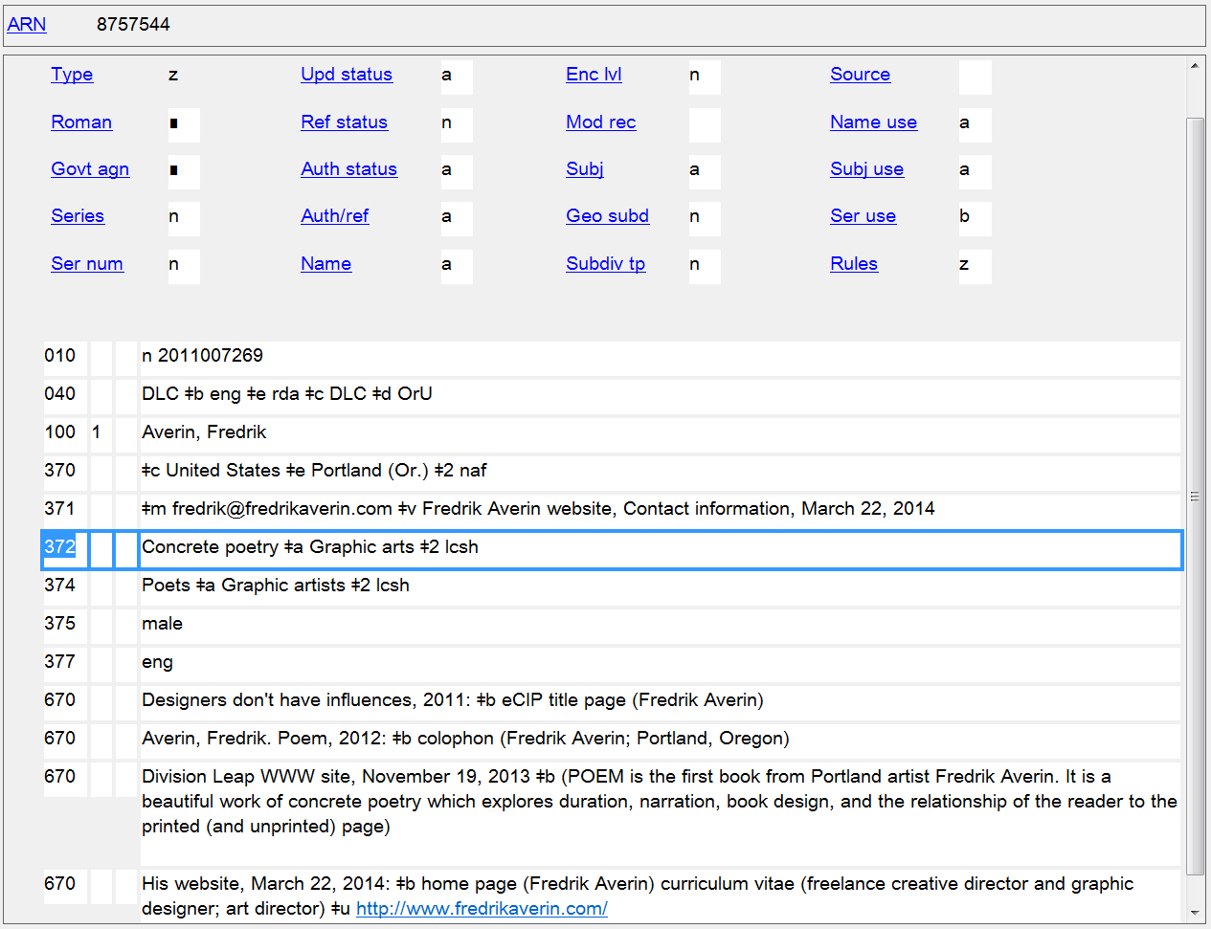
Field of Activity
372

Slide 68
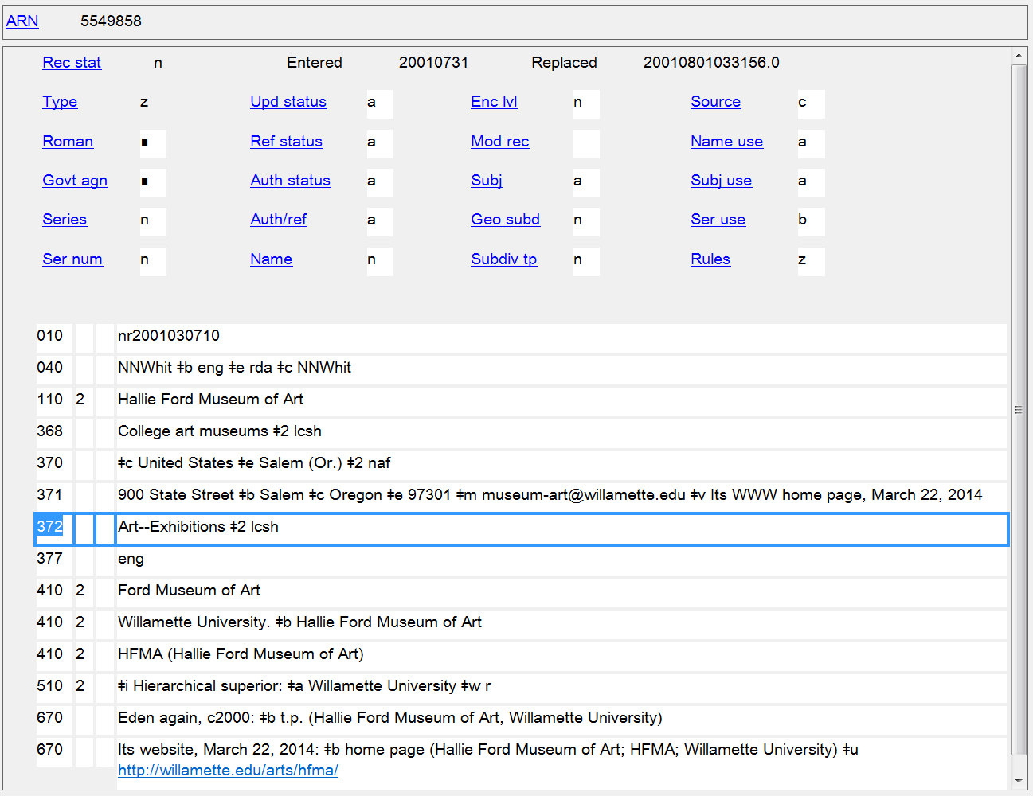
Field of Activity
372
Notes:
For LCSH, subject subdivisions are recorded with two hyphens separating each part of the subject heading string.

Slide 69
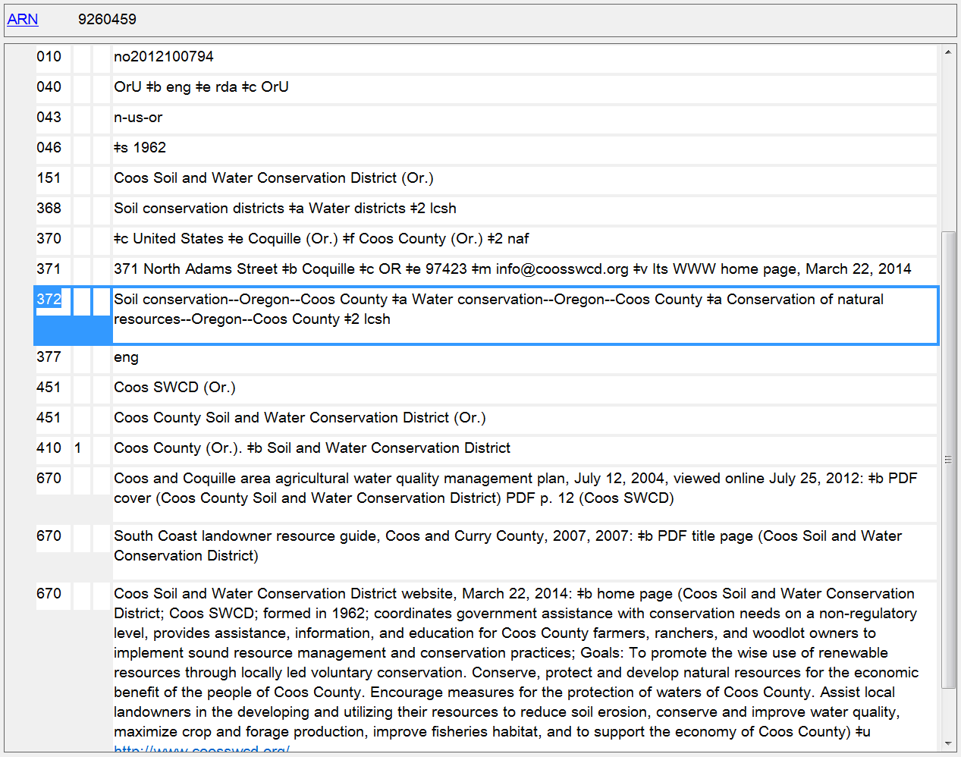
Field of Activity
372

Slide 70
Associated Group
Persons
9.13 Affiliation
Corporate Bodies
11.5 Associated Institution

Slide 71
373 - Associated Group
Indicators not defined
Subfields
$a - Associated group (R)
$s - Start period (NR)
$t - End period (NR)
$u - Uniform Resource Identifier (R)
$v - Source of information (R)
$0 - Record control number (R)
$2 - Source of term (NR)
$6 - Linkage (NR)
$8 - Field link and sequence number (R)

Slide 72
373 - Associated Group
PCC policies
Prefer a controlled vocabulary, such as the LC/NACO Authority File, giving source of name in subfield $2
Subfields found in authorized access point in LC/NACO Authority File are removed but punctuation is preserved:
Corporate name in LC/NAF:
110 1_ $a United States. $b Congress. $b Senate
Form of name in 373:
373 __ $a United States. Congress. Senate $2 naf

Slide 73
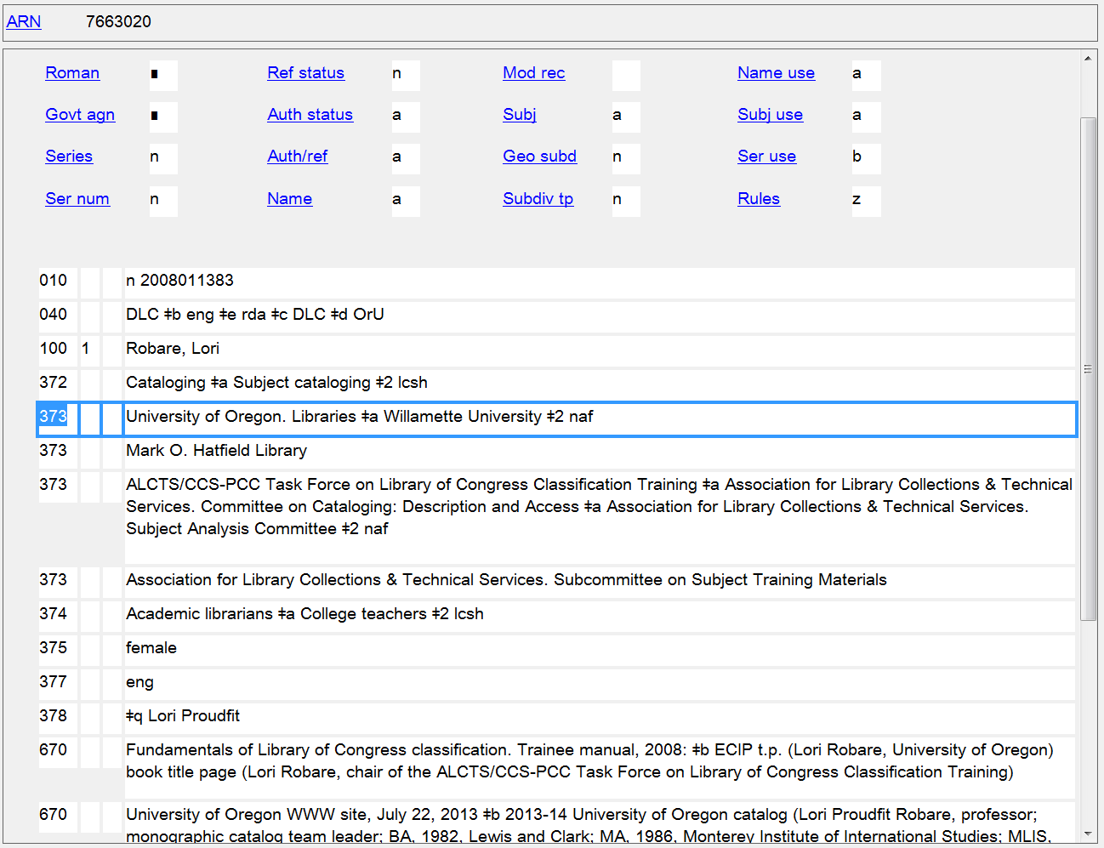
Affiliation
373

Slide 74
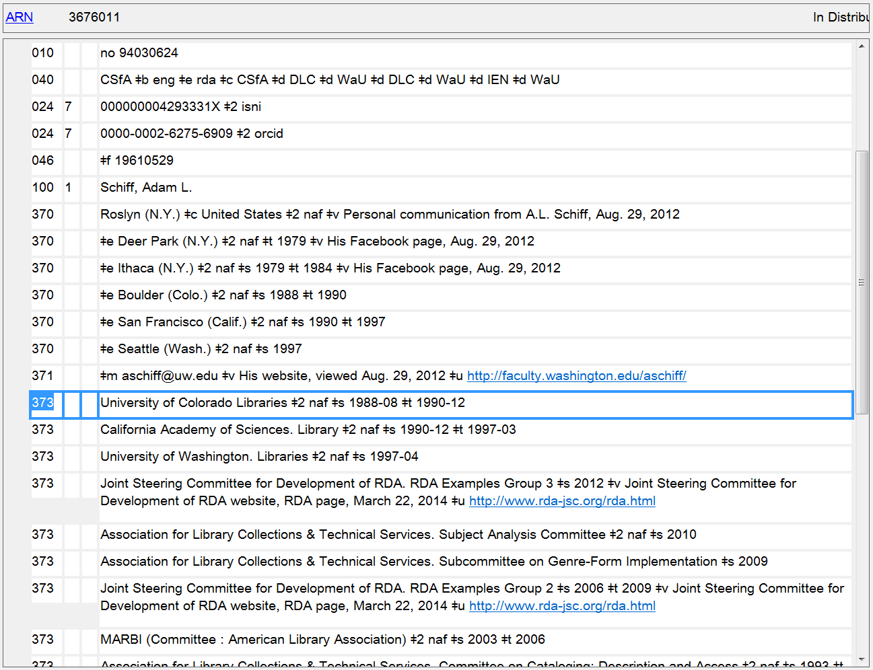
Affiliations, with dates when known
373
Notes:
Since I know all the detailed information for my attributes, I’ve supplied it in my NAR.

Slide 75
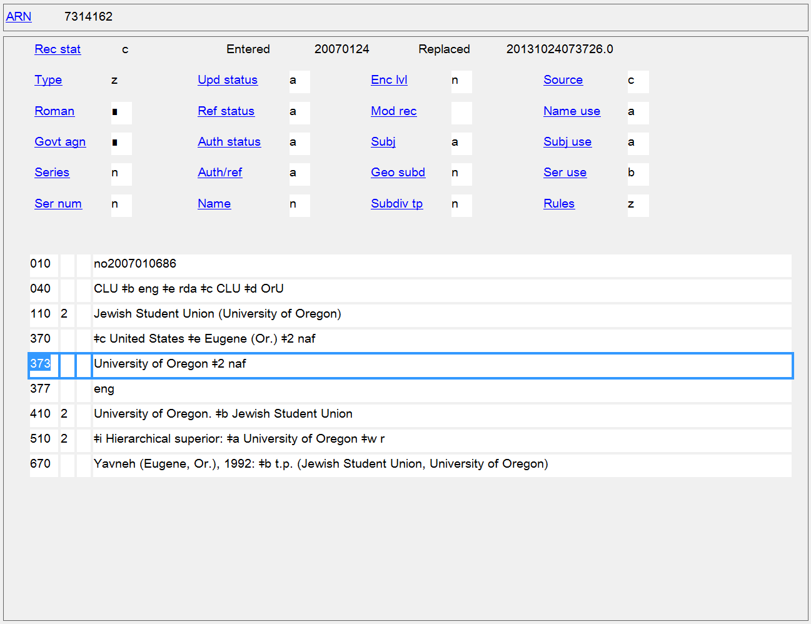
Associated Institution
373
Notes:
Associated institution recorded in the authorized access point and separately.

Slide 76
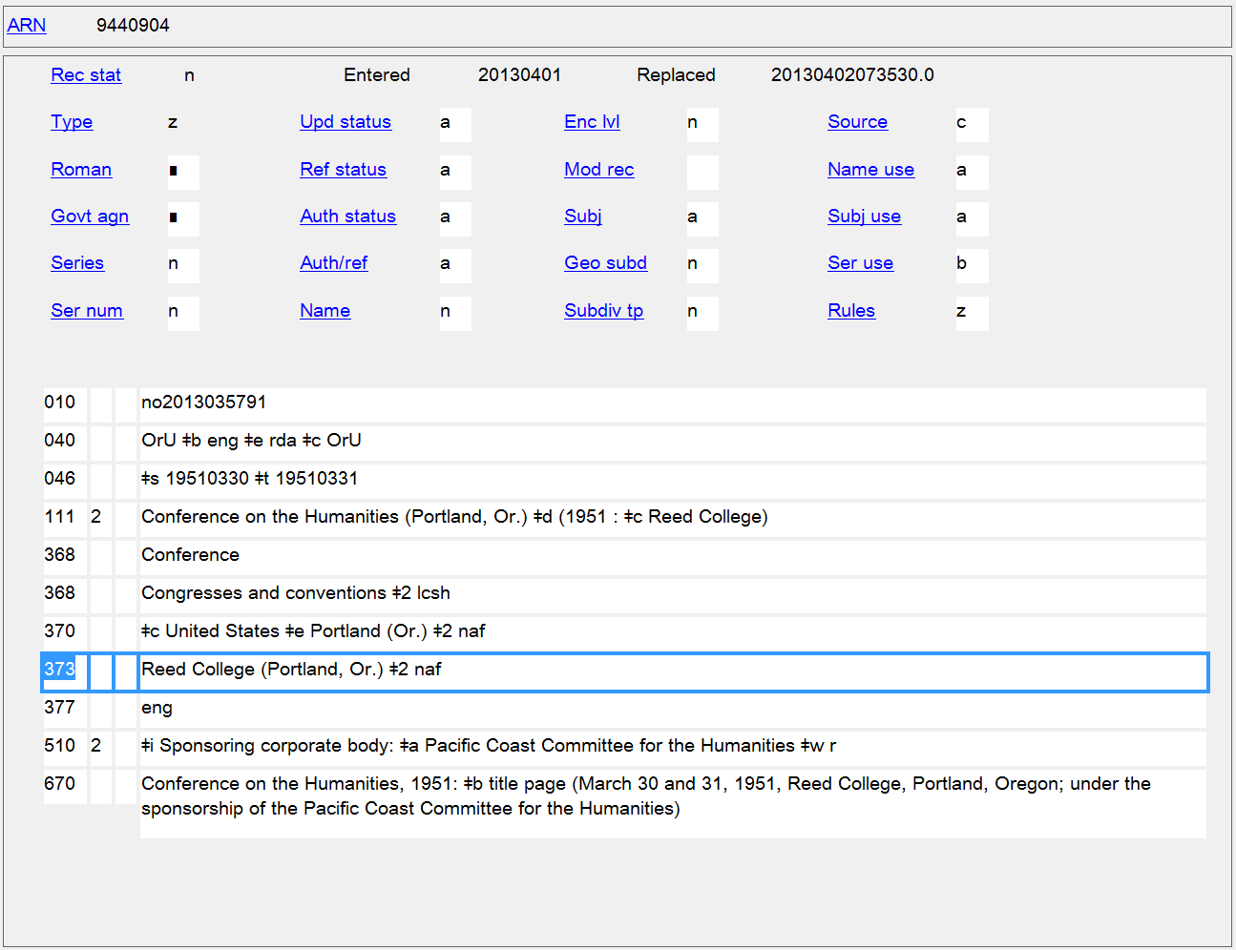
Associated Institution
373
Notes:
The preferred form of name of the associated institution (Reed College) is used in the authorized access point, but the authorized access point (which includes a qualifier) is recorded in the 373 field.
If you’re wondering why (Portland, Or.) is included as a qualifier after the conference name, it’s because there is a completely different conference with the same name, so the authorized access point for this conference needs to be differentiated from that one.

Slide 77
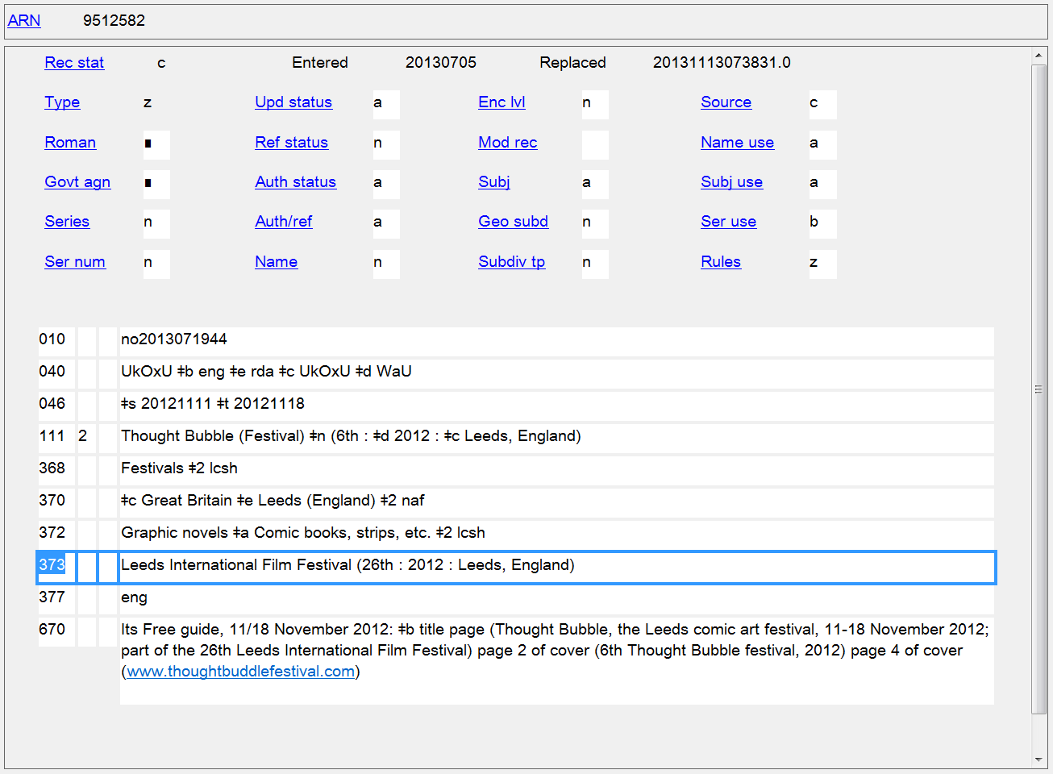
Associated Institution
373
Notes:
Interesting example of a festival that is part of another festival.

Slide 78
Language
Persons
9.14 Language of the Person
Families
10.8 Language of the Family
Corporate Bodies
11.8 Language of the Corporate Body
Works and Expressions
6.11 Language of Expression

Slide 79
377 - Associated Language
First Indicator not defined
Second Indicator
  # - MARC language code
  7 - Source specified in $2
Subfields
$a - Language code (R)
$l - Language term (R)
$2 - Source of code (NR)
$6 - Linkage (NR)
$8 - Field link and sequence number (R)

Slide 80
377 - Associated Language
PCC policies
Prefer language codes over language terms, using codes from the MARC Code List for Languages
Use subfield $l (Language term) only to provide information not available in the MARC Code List for Languages
Use second indicator value “7” and subfield $2 when a code is take from any language code list other than the MARC Code List for Languages. Source codes used in $2 are taken from the Language Code and Term Source Codes (http://www.loc.gov/standards/sourcelist/language.html)

Slide 81
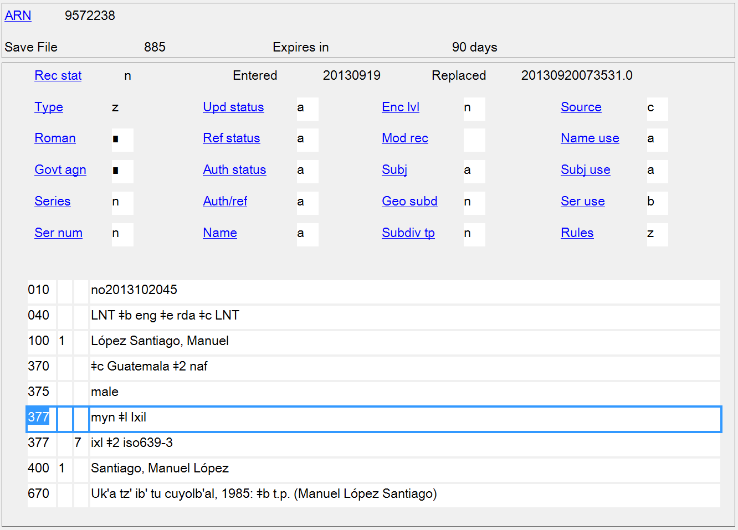
Language of the Person
377
Notes:
The MARC Code List for Languages has just a collective code for all Mayan languages, “myn”. In this case the author’s specific language is Ixil, so $l is added to the first 377 field to identify the specific language. Another code list (ISO 639-3) does have a specific code for Ixil so a second 377 was added for it.

Slide 82

Languages of the Corporate Body
377
Notes:
Multiple languages of a corporate body.

Slide 83

Language of Expression
377

Slide 84
Biography/History
Persons
9.17 Biographical Information
Families
10.9 Family History
Corporate Bodies
11.11 Corporate History
Works and Expressions
6.7 History of the Work

Slide 85
678 - Biographical or Historical Data
First Indicator
# - No information provided
1 - Biographical sketch
2 - Administrative history
Second Indicator not defined
Subfields
$a - Biographical or historical data (R)
$b - Expansion (NR)
$u - Uniform Resource Identifier (R)
$6 - Linkage (NR)
$8 - Field link and sequence number (R)
Notes:
This field already existed in MARC, but has found new life with RDA.

Slide 86
678 - Biographical or Historical Data
PCC policies
Construct the note in concise but complete sentences, keeping in mind that the information will be used in public displays.

Slide 87

Biographical Information
678
-

Slide 88

Family History
678

Slide 89

History of the Work
678
Notes:
There is no specific indicator value that can be used in 678 to identify history of the work, so first indicator # (blank) is used.

Slide 90
Other Attributes of Person or Corporate Body
9.4 - Title of the Person
9.6 - Other Designation Associated with the Person
9.6.1.4 - Saints
9.6.1.5 - Spirits
9.6.1.6 - Persons Named in Sacred Scriptures or Apocryphal Books
9.6.1.7 - Fictitious and Legendary Persons
9.6.1.8 - Real Non-human Entities
9.6.1.9 - Other Designation
11.7.1.4 - Type of Corporate Body
11.7.1.5 - Type of Jurisdiction
11.7.1.6 - Other Designation

Slide 91
368 - Other Attributes of Person or Corporate Body
Indicators not defined
Subfields
$a - Type of corporate body (R)
$b - Type of jurisdiction (R)
$c - Other designation (R)
$d - Title of person (R)
$s - Start period (NR)
$t - End period (NR)
$u - Uniform Resource Identifier (R)
$v - Source of information (R)
$0 - Authority record control number or standard number (R)
$2 - Source (NR)
$6 - Linkage (NR)
$8 - Field link and sequence number (R)

Slide 92
368 - Other Attributes of Person or Corporate Body
PCC policies
Prefer controlled vocabulary for terms, recording the source in subfield $2
For consistency, capitalize the first term in each subfield $a, $b and $c
Until further notice LC/PCC catalogers are asked NOT to supply the following subfields: $d (Title of person), $s (Start period), $t (End period), $u (Uniform Resource Identifier), and $v (Source of Information)

Slide 93

Title of the Person
368 $d
Notes:
An example of Title of the Person (368 $d). However, $d is not yet being used in name authorities, so this screen shot has been doctored up.

Slide 94

Title of the Person
368 $d
Notes:
Another example of Title of the Person (368 $d). However, $d is not yet being used in name authorities.
9.4.1.9 Other Term of Rank, Honour, or Office
Record other titles of the person indicative of rank, honour, or office if the terms appear with the name. Record the term in the language in which it was conferred or in the language used in the country in which the person resides.
EXAMPLE
Captain
Reverend
Sir

Slide 95

Other Designation: Saints
368 $c
Notes:
Note that two 368 $c are given here, one with controlled vocabulary from LCSH.

Slide 96

Other Designation: Spirits
368 $c
Notes:
The addition to the access point is in the singular, but the controlled vocabulary term from LCSH is plural.

Slide 97

Other Designation: Persons Named in Sacred Scriptures and Apocryphal Books
368 $c
Notes:
There is no controlled vocabulary available for this kind of term, so it is identical in the qualifier for the authorized access point and in the separate element. No $2 because the term doesn’t come from a controlled vocabulary.

Slide 98

Other Designation: Fictitious and Legendary Persons
368 $c
Notes:
The qualifier in the authorized access point is singular, but there is a plural form in LCSH that has been recorded in the separate element.

Slide 99

Other Designation: Fictitious and Legendary Persons
368 $c
Notes:
Other designation for fictitious and legendary persons is a core element in RDA, but it is only required in the authorized access point when needed to distinguish one person from another with the same name. In this case “Fletcher, Jessica” is a unique name. The other designation is recorded only in the separate element field, in this case in its established form in LCSH.

Slide 100

Other Designation: Fictitious and Legendary Persons
368 $c
Notes:
Another type of fictitious or legendary person: a deity. The first 368 reflects an uncontrolled term, which terms from LCSH for the type of entity are recorded in the second 368.

Slide 101

Other Designation: Real Non-human Entities
368 $c
Notes:
Example of a real non-human entity. The qualifier in the authorized access point is in the singular, but the controlled term from LCSH in the separate element is plural.

Slide 102

Other Designation: Real Non-human Entities
368 $c
Notes:
In this case, the other designation for a real non-human entity was not needed in the authorized access point (the name Keiko conveys the idea of a person, and the dates distinguish this person from any others). But the other designation is still a core element and is recorded as a separate element in 368 $c in the established term from LCSH for this species.

Slide 103

Other Designation: Any Other Designation
368 $c
Notes:
Finally, RDA has a catch-all element “any other designation” that can be used as a last resort to distinguish persons. In this situation, it’s unlikely that the designation used will have a controlled equivalent, so when recorded in 368 $c there is usually no $2.

Slide 104

Other Designation: Any Other Designation
368 $c

Slide 105

Other Designation: Any Other Designation
368 $c
Notes:
In this example, however, there is a controlled form of the designation available in LCSH, so the qualifier in the authorized access point is singular, while the controlled LCSH form is plural.

Slide 106

Other Designation: Any Other Designation
368 $c

Slide 107

Type of Corporate Body
368 $a
Notes:
For corporate bodies, there are three elements that can be recorded in field 368: type of corporate body ($a), type of jurisdiction ($b), and other designation ($c).
In this example a qualifier for type of corporate is included in the authorized access point (in the singular form), and recorded separately as well (in the plural LCSH form).

Slide 108

Type of Corporate Body
368 $a
Notes:
An example of singular uncontrolled form matching the qualifier in the authorized access point, and a separate controlled form for type of corporate body also recorded in a second instance of this element.

Slide 109

Type of Corporate Body
368 $a
Notes:
Singular uncontrolled form that matches the qualifier has been recorded, along with two pertinent controlled forms from LCSH for type of corporate body.

Slide 110

Type of Corporate Body
368 $a
Notes:
Type of corporate body recorded even though it isn’t needed in the authorized access point.

Slide 111

Type of Corporate Body
368 $a
Notes:
Two types of corporate body recorded separately. Since they both come from LCSH, subfield $a can be repeated.

Slide 112

Type of Corporate Body
368 $a

Slide 113

Type of Jurisdiction
368 $b
Notes:
Type of jurisdiction recorded in both the authorized access point, and as a separate element. Since the term doesn’t come from a controlled list, no $2 is present in the 368.

Slide 114

Type of Jurisdiction
368 $b
Notes:
Another similar example for type of jurisdiction.

Slide 115

Type of Jurisdiction
368 $b
Notes:
Here, two types of jurisdiction have been recorded even though they are not needed in the authorized access point.

Slide 116

Type of Jurisdiction
368 $b
Notes:
Another type of jurisdiction recorded separately but not in the authorized access point.

Slide 117

Type of Jurisdiction
368 $b
Notes:
Similar example to the previous one.

Slide 118

Other Designation
368 $c
Notes:
Other designation associated with a corporate body is any term used to differentiate the body that doesn’t fit into type of corporate body or type of jurisdiction. In this example the controlled form in LCSH is identical to the form used in the qualifier.

Slide 119

Other Designation
368 $c
Notes:
Another example of an uncontrolled term used as an other designation.
Note also that this example shows a variety of controlled terms from different vocabularies being recorded for type of jurisdiction (368 $b).

Slide 120

Other Designation
368 $c
Notes:
Another example of an uncontrolled term used as an other designation.
Note also that this example shows a variety of controlled terms from different vocabularies being recorded for type of jurisdiction (368 $b).

Slide 121

Other Designation
368 $c

Slide 122

Other Designation
368 $c
Notes:
The access point shown here has two different types of qualifiers in it: type of corporate body (Battleship) and other designation (BB-11). The first 368 shows uncontrolled vocabulary for each of these elements, while the second 368 shows two controlled terms from LCSH for the type of corporate body.

Slide 123
Other Person Elements
9.5 - Fuller Form of Name - MARC 378
9.7 - Gender - MARC 375
9.16 - Profession or Occupation - MARC 374

Slide 124
378 - Fuller Form of Personal Name
Indicators not defined
Subfields
$q - Fuller form of personal name (NR)
$u - Uniform Resource Identifier (R)
$v - Source of information (R)
$6 - Linkage (NR)
$8 - Field link and sequence number (R)

Slide 125

Fuller Form of Personal Name
378 $q
Notes:
In this example, the fuller form of name has be added to the authorized access point.

Slide 126

Fuller Form of Personal Name
378 $q
Notes:
In this example, the fuller form of name has been recorded as a separate element only, and is not part of the authorized access point.

Slide 127
375 - Gender
Indicators not defined
Subfields
$a - Gender (R)
$s - Start period (NR)
$t - End period (NR)
$u - Uniform Resource Identifier (R)
$v - Source of information (R)
$2 - Source of term (NR)
$6 - Linkage (NR)
$8 - Field link and sequence number (R)
Notes:
RDA gives a list of three terms that can be recorded for gender: female, male, or unknown. In addition if none of these are specific or precise enough, terms from other lists can be used. However, $2 codes do not yet validate in OCLC. This should change when OCLC implements the most recent MARC 21 changes later this spring (May or June?).

Slide 128

Gender
375
Notes:
Example of a person who has changed their gender. Start and termination dates ($s and $t) can be used to indicate what time period applies to each gender.

Slide 129
374 - Occupation
Indicators not defined
Subfields
$a - Occupation (R)
$s - Start period (NR)
$t - End period (NR)
$u - Uniform Resource Identifier (R)
$v - Source of information (R)
$0 - Record control number (R)
$2 - Source of term (NR)
$6 - Linkage (NR)
$8 - Field link and sequence number (R)

Slide 130
374 - Occupation
PCC policies
Prefer controlled vocabulary, such as LCSH or MeSH, recording the source in subfield $2
For consistency, capitalize the first term in each subfield $a
When terms do not come from a controlled vocabulary, use a singular form

Slide 131

Occupation
374
Notes:
Profession or occupation has been added to the authorized access point to break a conflict with another person with the same name. As part of the access point, it will always be in the singular. As a separate element, it may be plural or singular, depending on the source of the term. If it comes from a controlled vocabulary like LCSH that uses plural terms, it will be plural. If it doesn’t come from a controlled vocabulary, it will be in the singular.

Slide 132

Occupation
374

Slide 133

Occupation
374

Slide 134

Occupation
374
Notes:
An example of an uncontrolled profession/occupation term.

Slide 135

Occupation
374
Notes:
Most catalogers are using LCSH as the source of controlled vocabulary for this element, but other thesauri are perfectly valid to use as well. This record shows the use of a term from MeSH.

Slide 136

Notes:
There is a special list of Occupation Term Source Codes that could be used for field 374.

Slide 137

Occupation
374
Notes:
An example of a controlled vocabulary for occupations that is in the singular, the Dictionary of Occupational Titles - coded “dot”

Slide 138
Other Family Elements
10.3 - Type of Family - MARC 376 $a
10.6 - Prominent Member of the Family - MARC 376 $b
10.7 - Hereditary Title - MARC 376 $c

Slide 139
376 - Family Information
Indicators not defined
Subfields
$a - Type of family (R)
$b - Name of prominent member (R)
$c - Hereditary title (R)
$s - Start period (NR)
$t - End period (NR)
$u - Uniform Resource Identifier (R)
$v - Source of information (R)
$0 - Record control number (R)
$2 - Source of term (NR)
$6 - Linkage (NR)
$8 - Field link and sequence number (R)

Slide 140

376 - Family Information
PCC policies
For names of prominent members, give the authorized access point form. Do not include any internal subfield coding in subfield $b.

Slide 141
Other Work/Expression Elements
6.3 Form of Work - MARC 380
6.6 Other Distinguishing Characteristic of the Work - MARC 381
6.9 Content Type - MARC 336
6.12 Other Distinguishing Characteristic of the Expression - MARC 381
6.15 Medium of Performance - MARC 382
6.16 Numeric Designation of a Musical Work - MARC 383
6.17 Key - MARC 384

Slide 142
Other Work/Expression Elements
6.18 Other Distinguishing Characteristic of the Expression of a Musical Work - MARC 381
6.21 Other Distinguishing Characteristic of a Legal Work - MARC 381
6.25 Other Distinguishing Characteristic of the Expression of a Religious Work - MARC 381

Slide 143
380 - Form of Work
Indicators not defined
Subfields
$a - Form of work (R)
$0 - Record control number (R)
$2 - Source of term (NR)
$6 - Linkage (NR)
$8 - Field link and sequence number (R)

Slide 144
380 - Form of Work
PCC policies
Prefer a controlled vocabulary, such as LCSH, LCGFT, or MeSH, or use a source term from the MARC Subject Heading and Term Source Codes or Genre/Form Source Codes in subfield $2 if appropriate.
For consistency, capitalize the first term in subfield $a.
When terms do not come from a controlled vocabulary, use the singular form.

Slide 145

Form of Work
380
Notes:
Form of work used as a qualifier in the authorized access point to distinguish the play from the novel by the same author. Uncontrolled term in field 380.

Slide 146

Form of Work
380
Notes:
Form of work not needed to differentiate this access point from any other, but it is recorded as a separate element anyway. Example shows an uncontrolled term in the singular and two terms from controlled vocabulary.
lcac = Library of Congress Annotated Children's Cataloging Program subject headings

Slide 147

Form of Work
380
Notes:
First 380 has the uncontrolled term that was also used in the authorized access point. The second 380 shows genre terms from LCGFT.

Slide 148

Form of Work
380

Slide 149

Form of Work
380
Notes:
Two controlled terms from LCSH recorded for form of work.

Slide 150
381 - Other Distinguishing Characteristics of Work or Expression
Indicators not defined
Subfields
$a - Other distinguishing characteristic (R)
$u - Uniform Resource Identifier (R)
$v - Source of information (R)
$0 - Record control number (R)
$2 - Source of term (NR)
$6 - Linkage (NR)
$8 - Field link and sequence number (R)
Notes:
Any characteristic that is not accommodated in a special field that serves to characterize a work or expression. Examples are an issuing body, arranged statement of music, version, or a geographic term. May be used to differentiate a work from another work with the same title.
Multiple characteristics from the same source vocabulary may be recorded in the same field in separate occurrences of subfield $a (Other distinguishing characteristic). Terms from different source vocabularies are recorded in separate occurrences of the field.

Slide 151

Other Distinguishing Characteristic of Work
381
Notes:
Issuing body used as a qualifier - also recorded separately in field 381.

Slide 152

Other Distinguishing Characteristic of Work
381
Notes:
Two paintings by the same artist with the same title. Art museum owning the painting used to differentiate the two works.

Slide 153

Other Distinguishing Characteristic of Work
381
Notes:
Surname of director added to access point for a film to differentiate it from another film with the same title from the same year. Surname also recorded separately in 381.

Slide 154

Other Distinguishing Characteristic of Expression
381

Slide 155

Other Distinguishing Characteristic of Expression
381
Notes:
Surname of translator added to access point to differentiate a specific English expression. Surname also recorded as a separate element in 381.

Slide 156

Other Distinguishing Characteristic of Expression
381

Slide 157
382 - Medium of Performance
First Indicator
# - No information provided
0 - Medium of performance
1 - Partial medium of performance
Second Indicator not defined
Subfields
$a - Medium of performance (R)
$b - Soloist (R)
$d - Doubling instrument (R)
$n - Number of performers of the same medium (R)
$p - Alternative medium of performance (R)
$s - Total number of performers (R)
$v - Note (R)
$0 - Authority record control number or standard number (R)
$2 - Source of term (NR)
$6 - Linkage (NR)
$8 - Field link and sequence number (R)

Slide 158
383 - Numeric Designation of a Musical Work
Indicators not defined
Subfields
$a - Serial number (R)
$b - Opus number (R)
$c - Thematic index number (R)
$d - Thematic index code (NR)
$e - Publisher associated with opus number (NR)
$2 - Source (NR)
$6 - Linkage (NR)
$8 - Field link and sequence number (R)

Slide 159
384 - Key
First Indicator
# - Relationship to original unknown
0 - Original key
1 - Transposed key
Second Indicator not defined
Subfields
$a - Key (NR)
$6 - Linkage (NR)
$8 - Field link and sequence number (R)

Slide 160

Medium of Performance 382
Numeric Designation 383
Key 384

Slide 161
336 - Content Type
Indicators not defined
Subfields
$a - Content type term (R)
$b - Content type code (R)
$2 - Source (NR)
$3 - Materials specified (NR)
$6 - Linkage (NR)
$8 - Field link and sequence number (R)
Terms from RDA 6.9
PCC policy: Do not supply

Slide 162

Content Type
336
Notes:
Although current PCC policy is not to supply 336, there are a handful of records with it in the LC/NACO authority file.

Slide 163
Enhancing Discovery
For catalogers
Attributes are searchable in OCLC Connexion
For patrons
Future scenarios:
  Semantic Web and linked data
Notes:
These fields recording attributes of FRBR group 1 and 2 entities support the FRAD and FRBR conceptual models. Not all systems/OPACs can take advantage of these but we are working toward future scenarios such as those envisioned by the Semantic Web that depend on linked data to make, visualize and connect relationships among and between names, corporate bodies, works, expressions, etc.

Slide 164

Searching the LC/NACO AF in OCLC Connexion
rda
librarians
Notes:
RDA attributes are permitted in both AACR2 and RDA authority records. Of course all newly created NARs are now done according to RDA. To limit a search to RDA authorities, search for “rda” in Descriptive Conventions. [FIRST ANIMATION]
To search for any attribute data, use the Entity Attributes index. [SECOND ANIMATION]

Slide 165


Slide 166


Slide 167

Notes:
How about generating a list of composers from Oregon?

Slide 168

Notes:
27 authority records are retrieved from the search for composers from Oregon.

Slide 169


Slide 170

Notes:
How about a list of fictitious authors?

Slide 171


Slide 172

Notes:
Other designation associated with the person is a core element for fictitious or legendary persons (see RDA 8.3 April 2014 revision) and must be recorded as a separate element, as part of the authorized access point representing the person, or as both. In this case, the name is unique and does not need a qualifier to differentiate it. However, since the element is core, it has been recorded in the 368 $c, which makes it possible to search the authority file for fictitious persons.

Slide 173

Notes:
How about we want to find examples of real-life cats as persons associated with resources? Like our fictitious persons examples, other designation associated with the person is a core element for real non-human entities (see RDA 8.3 April 2014 revision) and must be recorded as a separate element, as part of the authorized access point representing the person, or as both.

Slide 174

Notes:
The search retrieves any attribute that matches the query. Unfortunately at the present time OCLC Connexion doesn’t provide more specific searching options to limit the search to a particular element/attribute. I hope that in the future, OCLC will let us search by date of birth, occupation, place of residence/headquarters, etc. rather than lumping everything into just one “Entity Attributes” index.

Slide 175

Notes:
Here is a real life cat.

Slide 176

Notes:
Here’s a fictitious character who is a cat. There’s also another one in our retrieval set: Meeow (Fictitious character)

Slide 177

Notes:
This corporate body was retrieved in our search because the term “Cats” appears in the MARC field for field of activity. If we could have limited our search to just “Cats” as an other designation associated with a person, we could have eliminated false hits like this.

Slide 178

Notes:
Generate a list of films from 2001. I’ve used three terms likely to be included in the form of work attribute and combined them with the year 2001.

Slide 179

Notes:
Only a few results returned are actually films. Several issues that need work: more attribute information needs to be added to work authority records; we need to be able to be more specific in searching for particular attributes. In this case, it would be helpful to limit our search to just the form of work attribute.

Slide 180


Slide 181
The Future
What poetry by Oregon authors do you have?
Do you have music by French women composers of the 19th century?
How about recordings of rock bands from Portland?
I’m looking for novels written in the 1920s by people who were doctors or lawyers by profession.
Notes:
The catalog probably cannot answer any of these questions, but in the future hopefully, with linked data between bibliographic and authority records and links to other information sources on the Web, our systems will enable users to do these kinds of searches and return results showing what a specific library or consortium holds.

Slide 182

Notes:
Here’s a search to find authorities established for rock bands from Portland. I’ve searched for field of activity rock music or type of corporate body rock groups, combined with associated place Portland, Or.

Slide 183


Notes:
What we need, and hopefully will get, is a system that enables users to query authority records (though they won’t know they are doing that) for attributes of entities, and then returns bibliographic records of resources that have the access points found as a result of the initial search. Hopefully, library system developers will take advantage of the potential of linked data and all of the new information that we are including in authority records.

