Slide 1
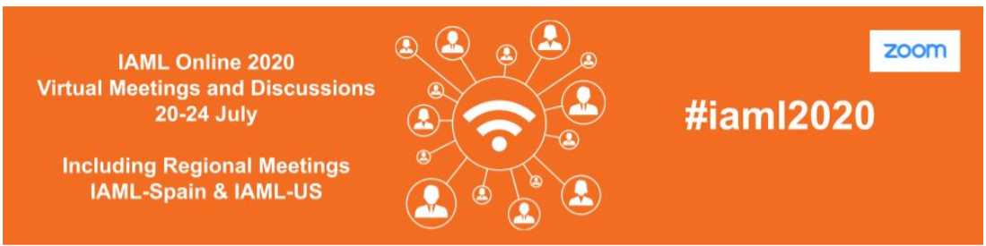
IAML 70th Anniversary 2021
Notes:
I would like to remind you of the fact that IAML will celebrate its 70th anniversary next year. This will certainly be commemorated during the congress in Prague, but I would like to encourage you all to highlight the anniversary on a national level during 2021. Let us use this opportunity to strengthen the ties between the national branches and what we use to call “big IAML”! The anniversary is also a perfect incentive for outreach and membership recruitment. With joint efforts we can give IAML extra visibility around the world all through the year.
To assist you, I would like to draw your attention to some useful resources on the IAML website.

Slide 2
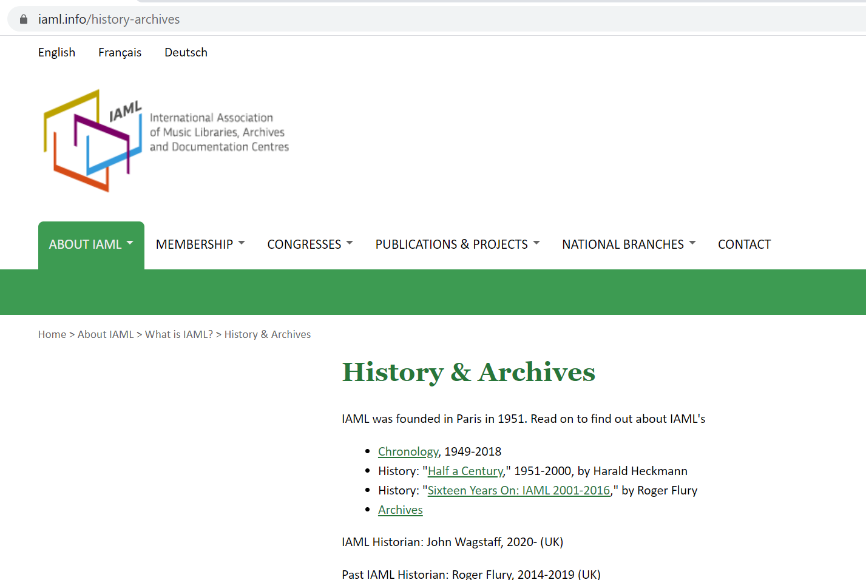
Notes:
A good starting point is the page History & Archives.

Slide 3
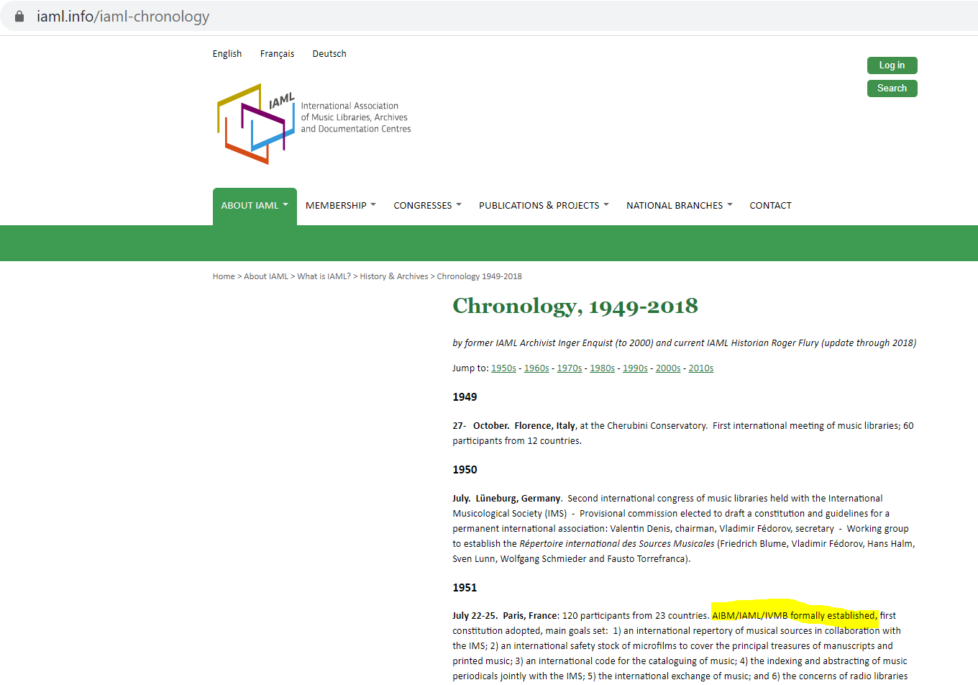
Notes:
First of all, I hope you are aware of the excellent Chronology that goes back all the way to 1949. The Chronology testifies to the fact that IAML is an association to be truly proud of. And that we are not resting on our laurels. There has been a constant development, not least during the last ten years when we have worked together to shape what we called “the Future of IAML”.

Slide 4
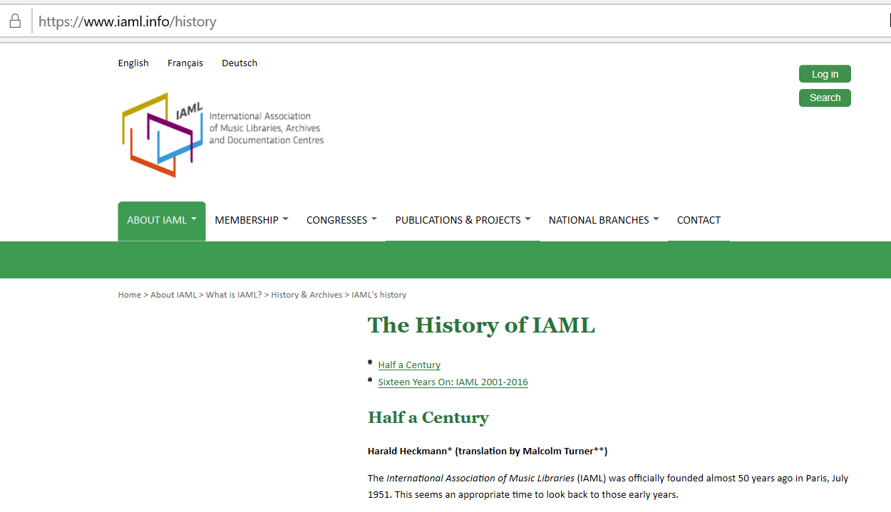
Notes:
There are also two inspiring articles published on the website, written by Harald Heckman, Honorary President of IAML and Roger Flury, past IAML Historian, that give important overviews of and personal reflections on the history of our Association. Heckman’s article covers the first fifty years of IAML’s history and Flury’s the following sixteen years.

Slide 5
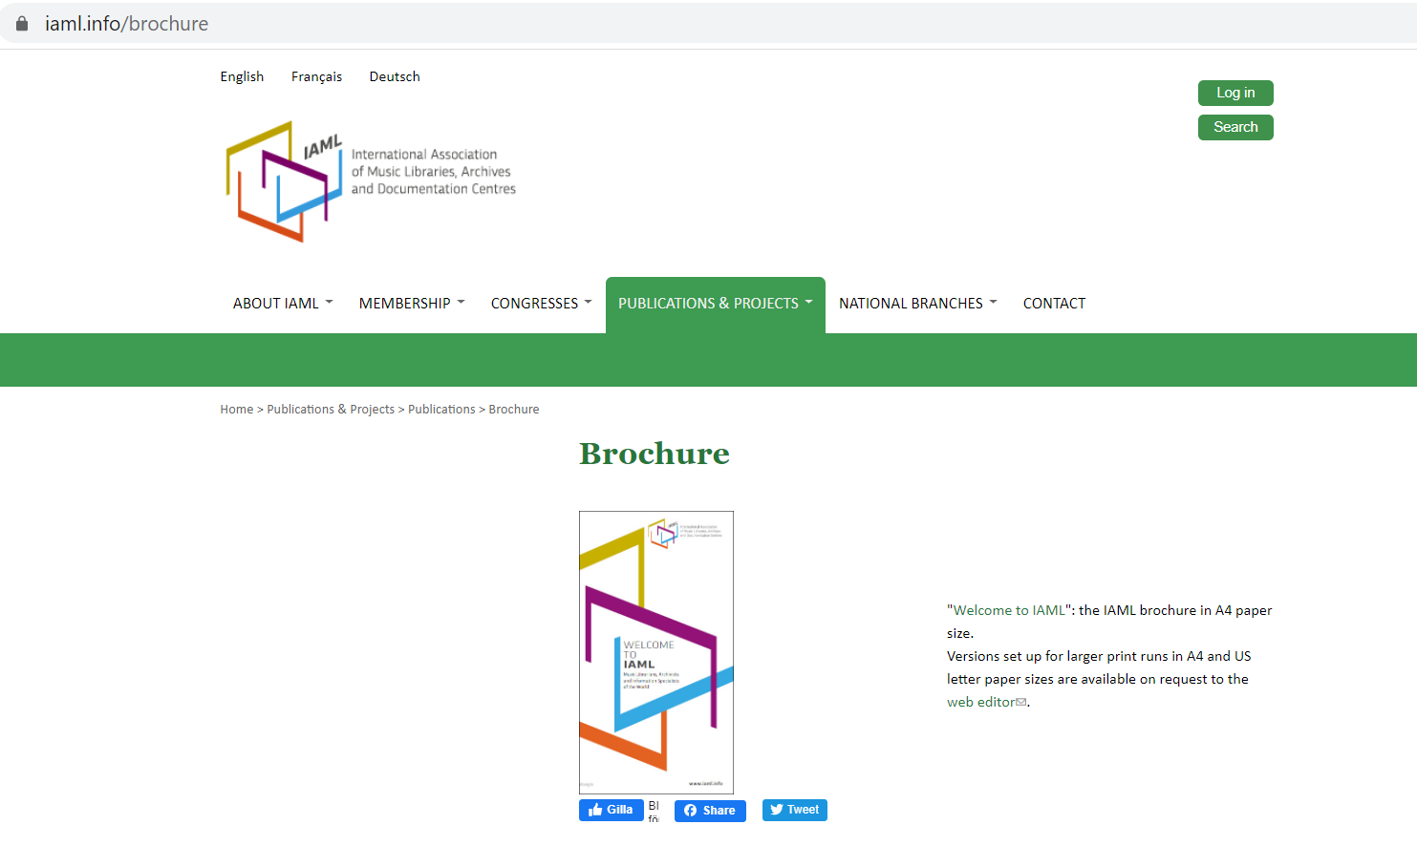
Notes:
The brochure “Welcome to IAML” can be downloaded in an A4 size from the website.
Versions set up for larger print runs in A4 and US letter paper sizes are available on request to the web editor.
Please, don’t hesitate to contact me if you would like me to send you printed flyers. I would be happy to do so and we still have quite a few left.

Slide 6
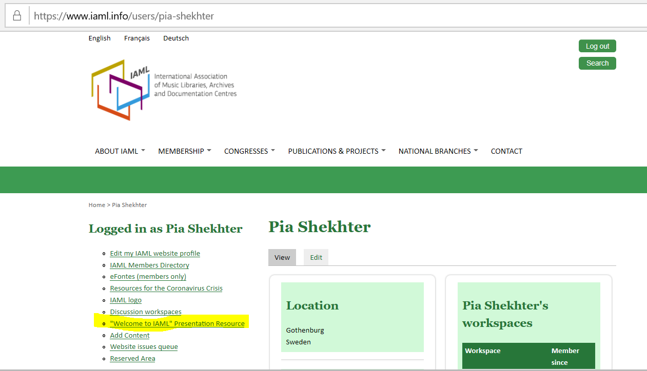
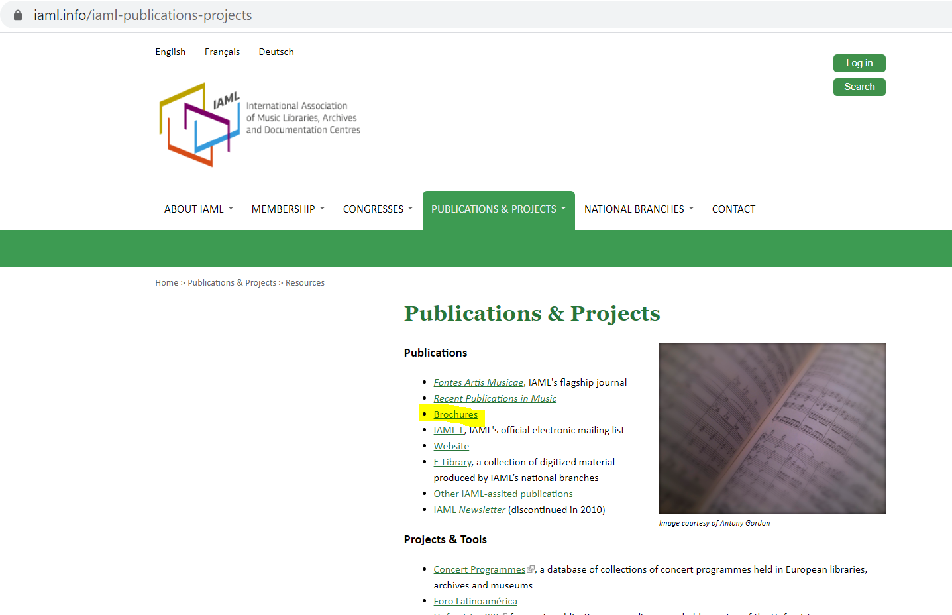
Notes:
In case you would like to make a presentation of IAML there is a "Welcome to IAML" Presentation Resource that you can download from the website. Please, observe that you need to log in to access the Power Point.

Slide 7
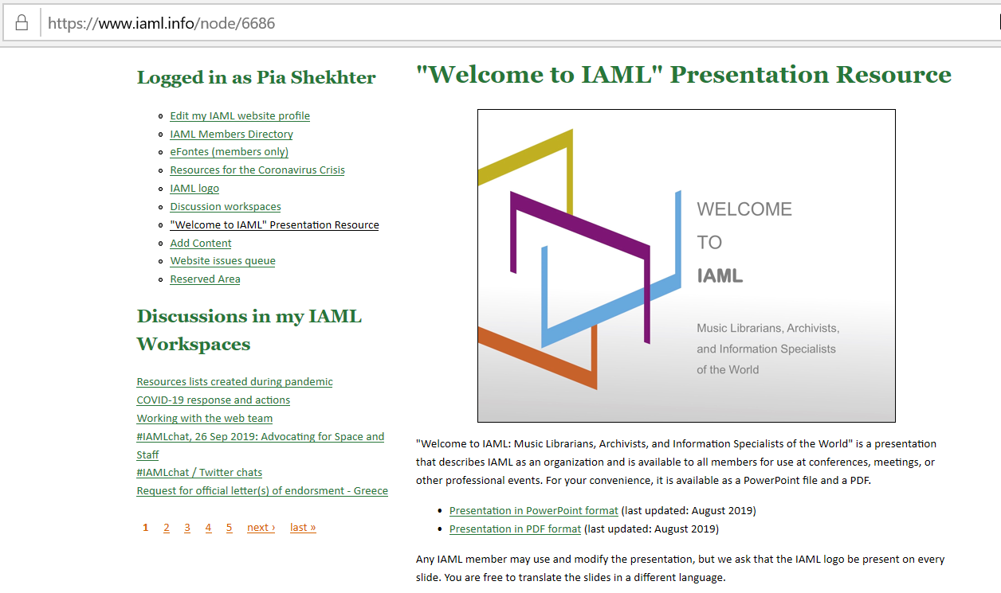
Notes:
The presentation that describes IAML as an organization is available to all members for use at conferences, meetings, or other professional events.

Slide 8
IAML’s communication channels
Membership journal Fontes Artis Musicae
Website (newsfeed, workspaces, etc.) www.iaml.info
Discussion list iaml-l@cornell.edu
Facebook iamlaibm
Twitter IAML_AIBM
Instagram iaml.aibm
Flickr iaml_aibm
Spotify iaml_aibm
YouTube click here*
* https://www.youtube.com/channel/UCFfN1UX5wdevcYXeSr5njfQ/about
Notes:
And last, but definitely not least: do remember all the different channels we can use to communicate between ourselves and reach out to our environment.

Slide 9
Thank you for your attention!
Pia Shekhter, IAML Online 2020
Notes:
Thank you!

